Slide 1
Map interpretation
Paper 2
15 Marks Multiple Choice (Info in margins, map code, direction etc.)
20 Marks Calculations
25 Marks map interpretation
15 Marks GIS
Total: 75
Duration: 1 ½ Hour

Slide 2
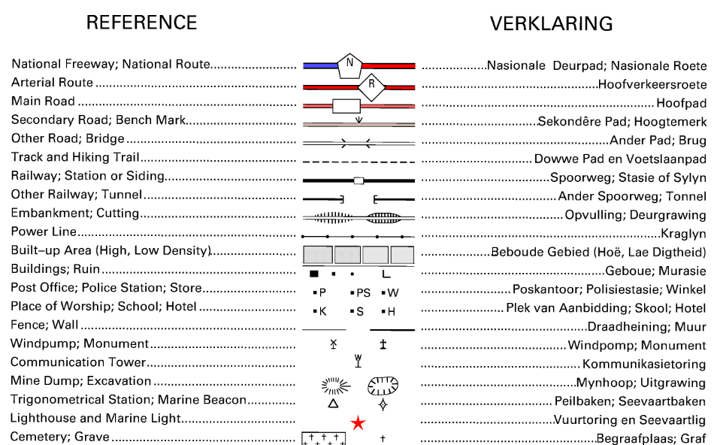
You must know the conventional map symbols

Slide 3
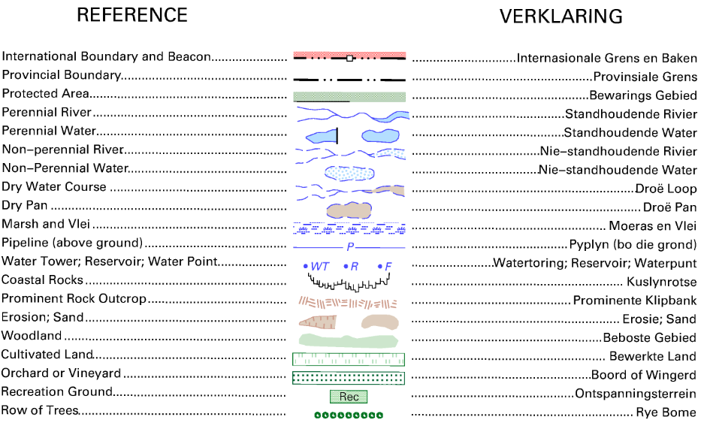
You must understand what each one imply about the mapped area

Slide 4
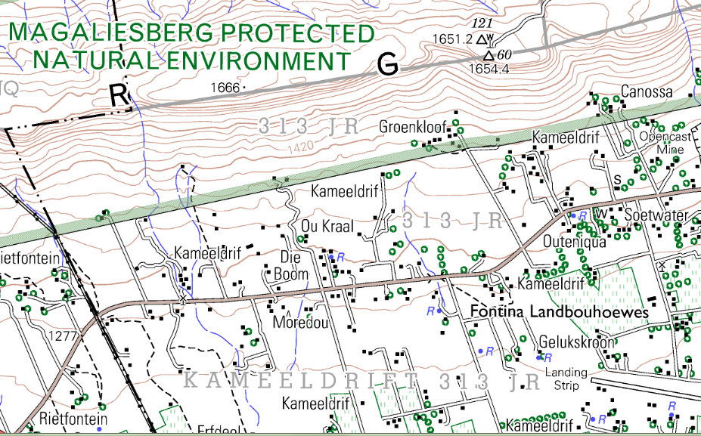
Aspect, Valley winds, climate, Slopes, landforms, Settlement, Land use

Slide 5
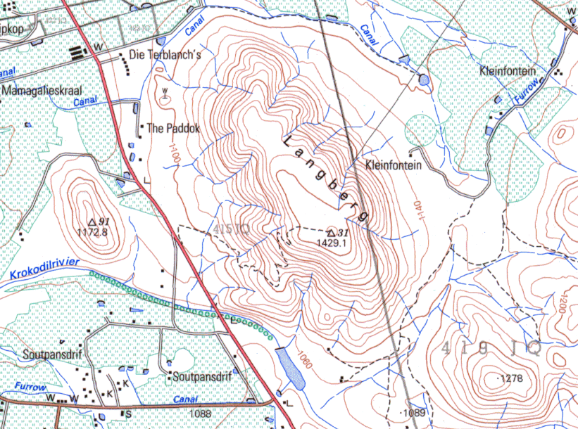
Landforms, land use, type of farming, direction of flow of river

Slide 6
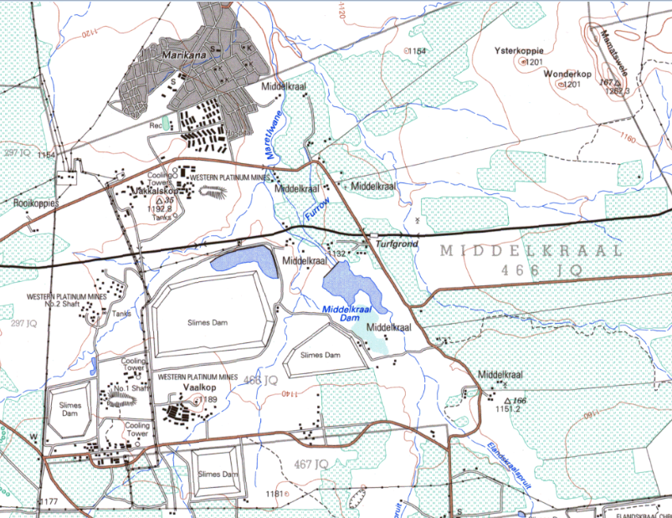
Economic activities

Slide 7
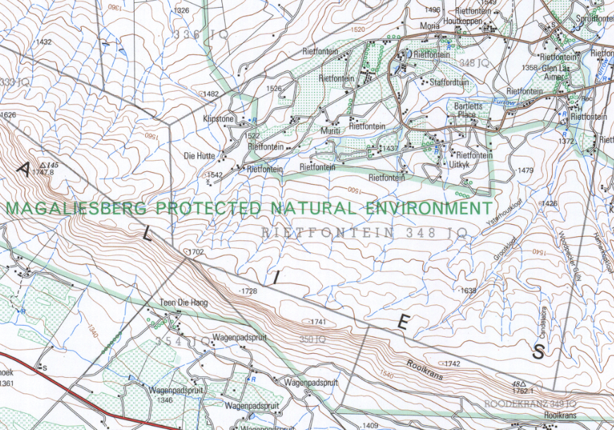
Landforms, slopes, micro-climate, farming, recreation, conservation

Slide 8
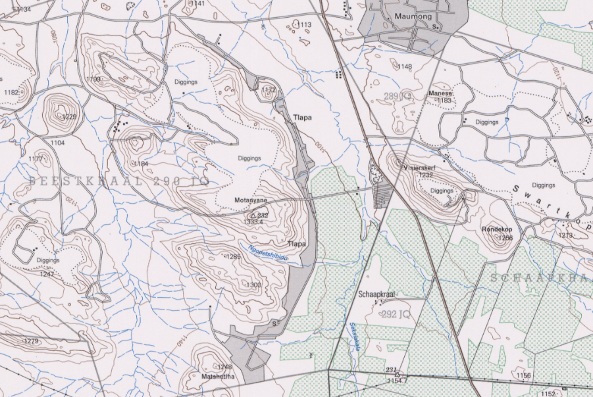
Shape of settlement, landforms, land use / topography

Slide 9
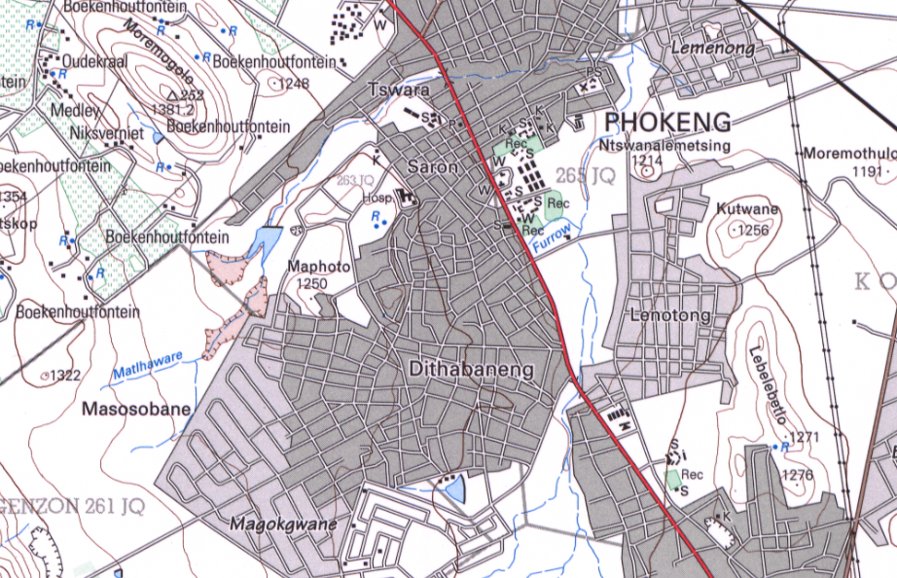
Types of settlement, settlement patterns, street patterns, landforms, rainfall

Slide 10
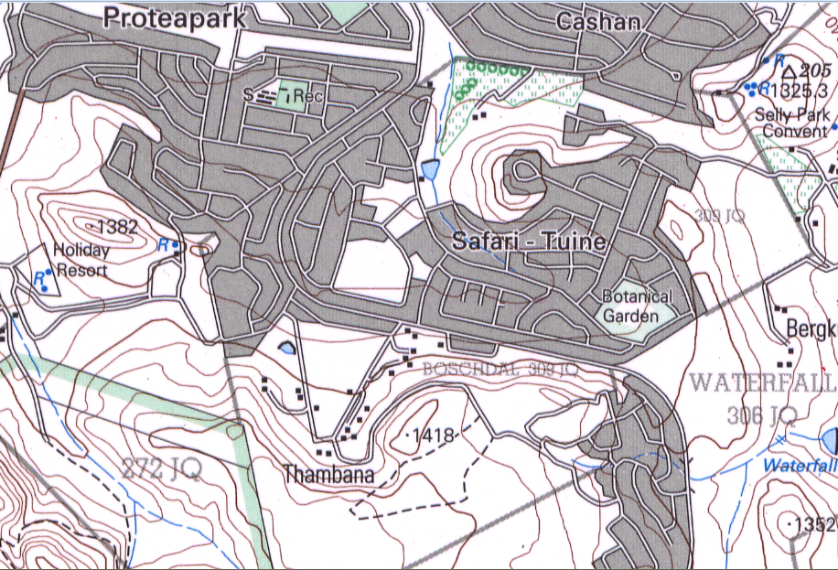
Street patterns/ topography, land-use

Slide 11
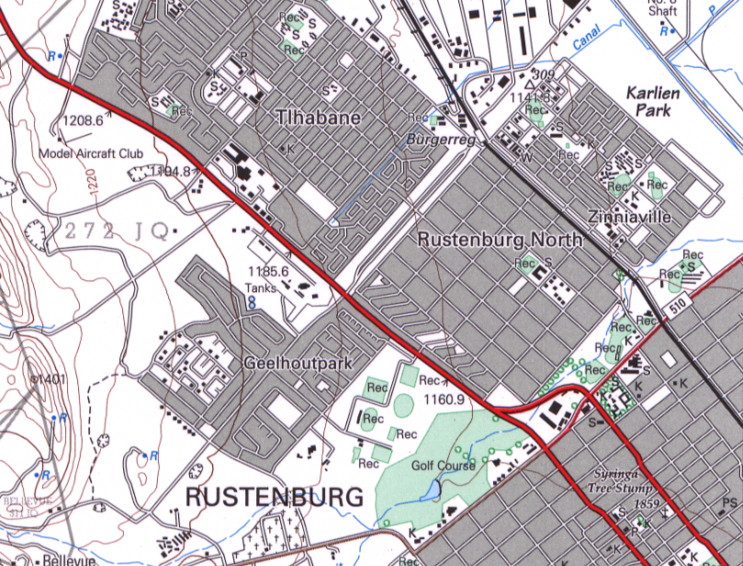

Slide 12
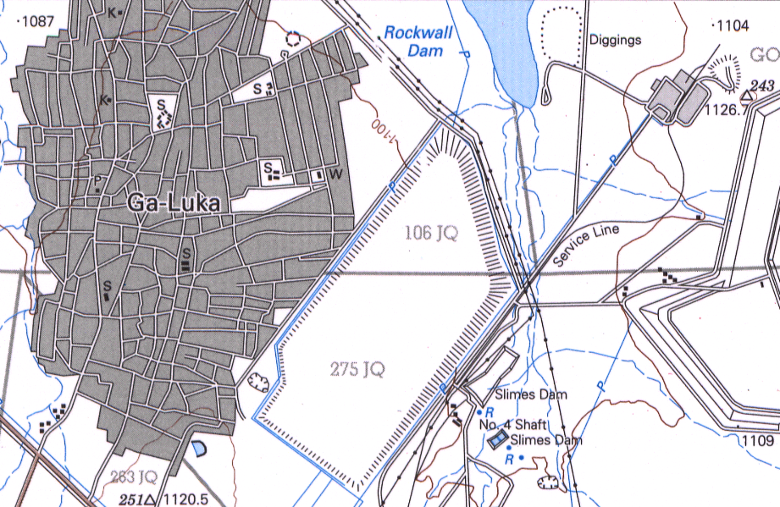

Slide 13
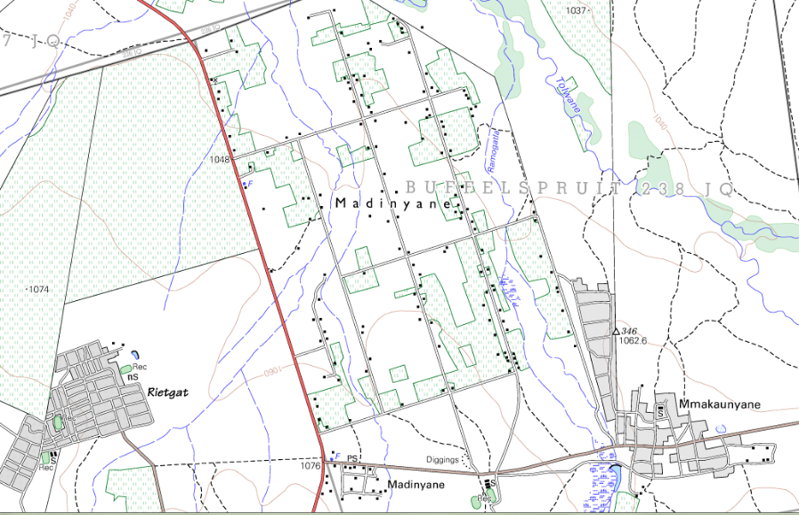

Slide 14
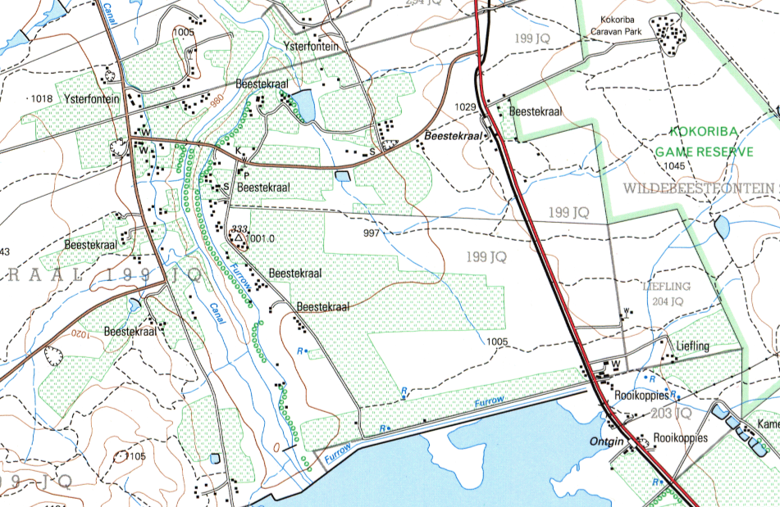

Slide 15
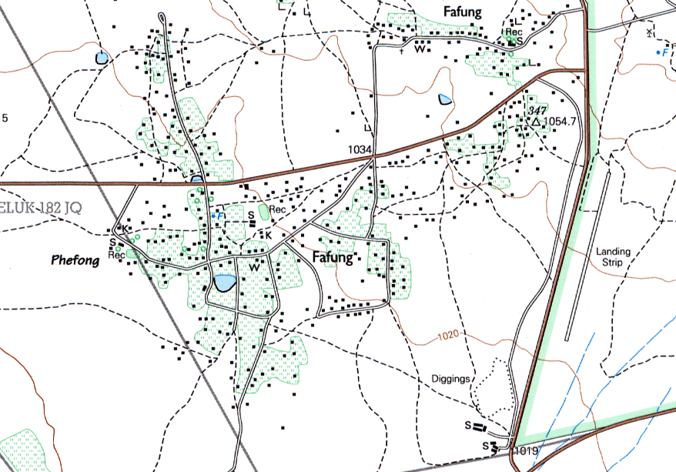

Slide 16
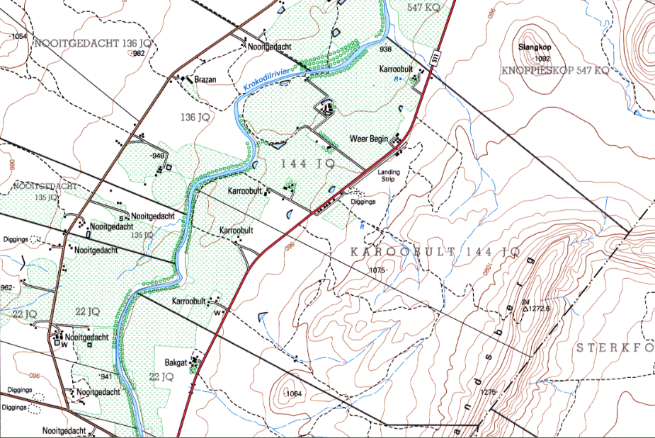

Slide 17
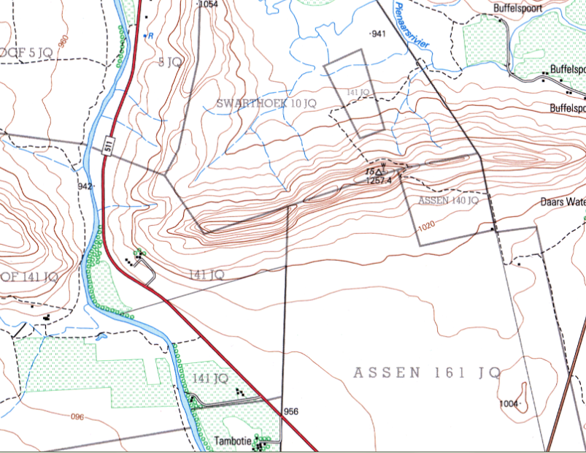

Slide 18
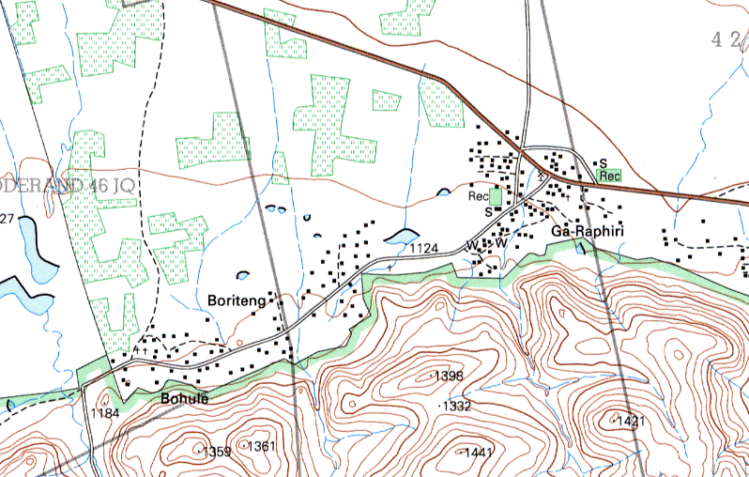

Slide 19
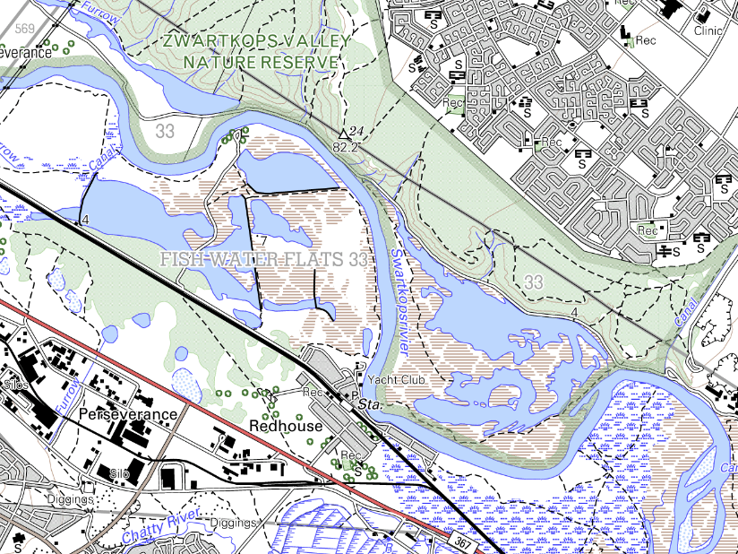

Slide 20
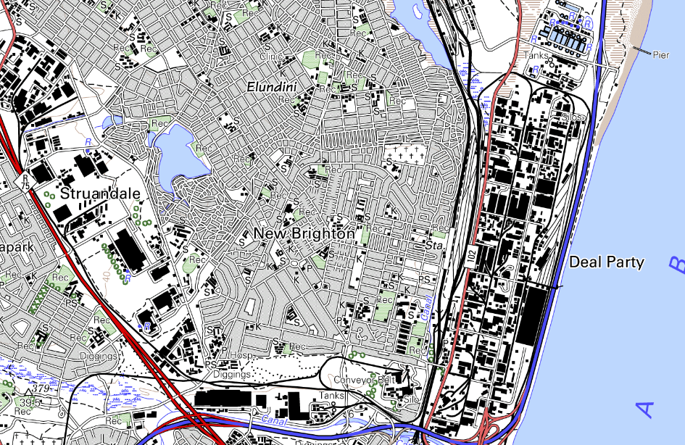

Slide 21
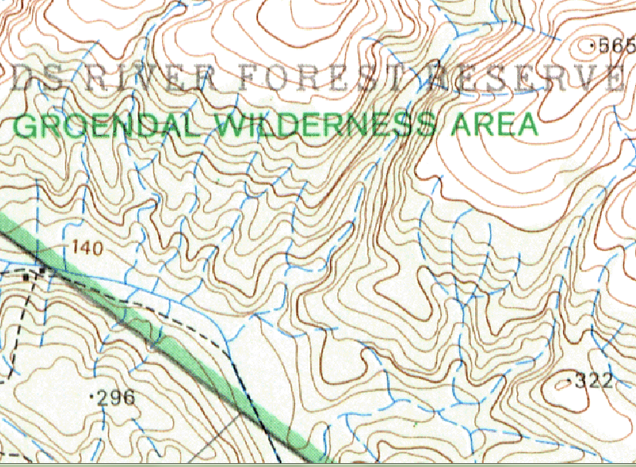

Slide 22
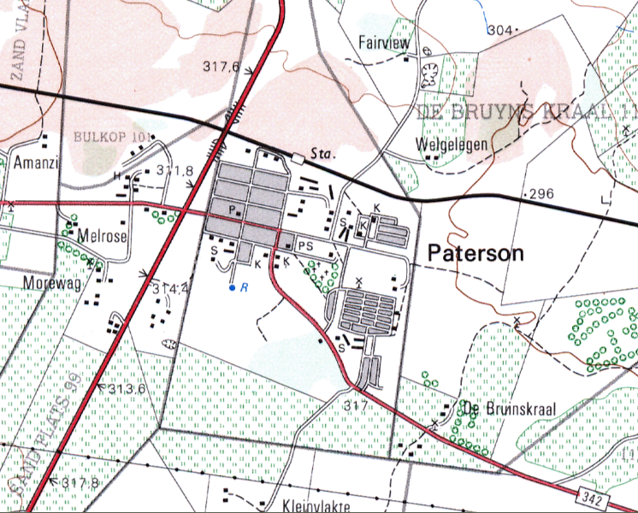

Slide 23
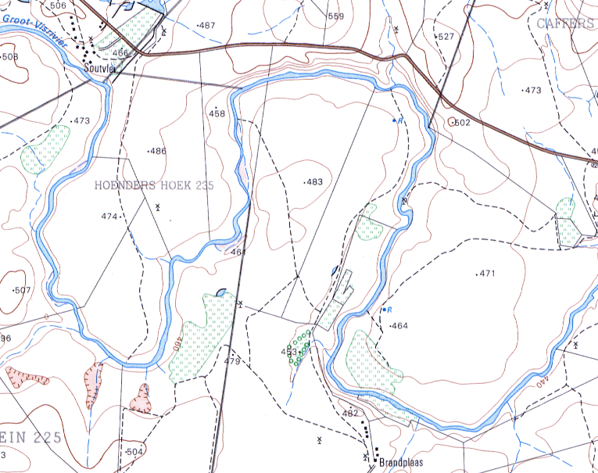

Slide 24
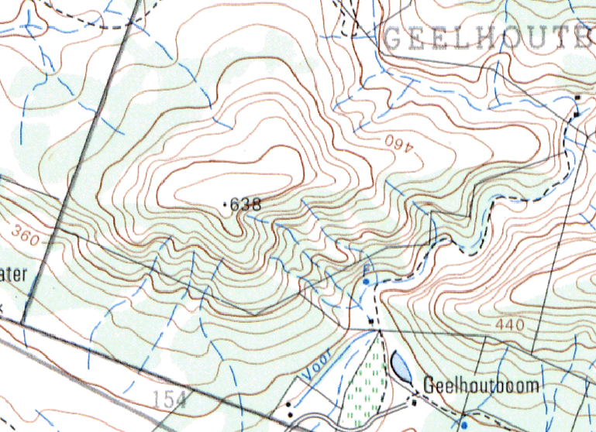

Slide 25
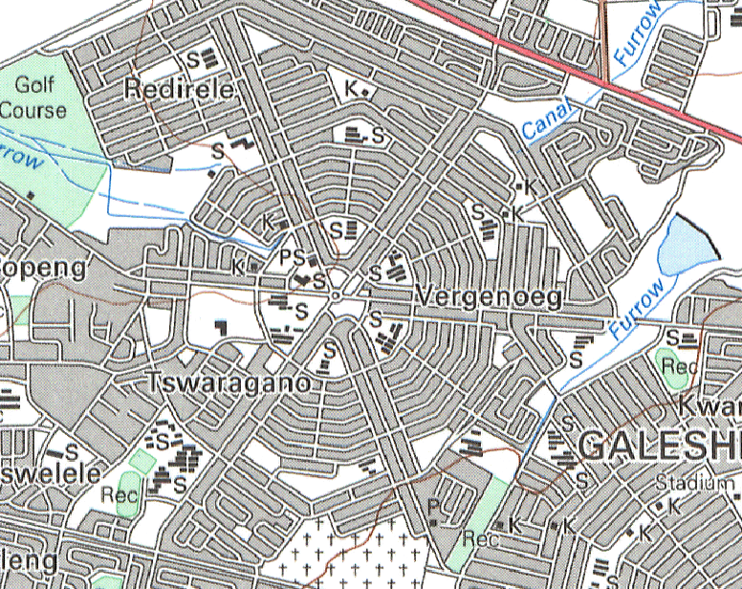

Slide 26
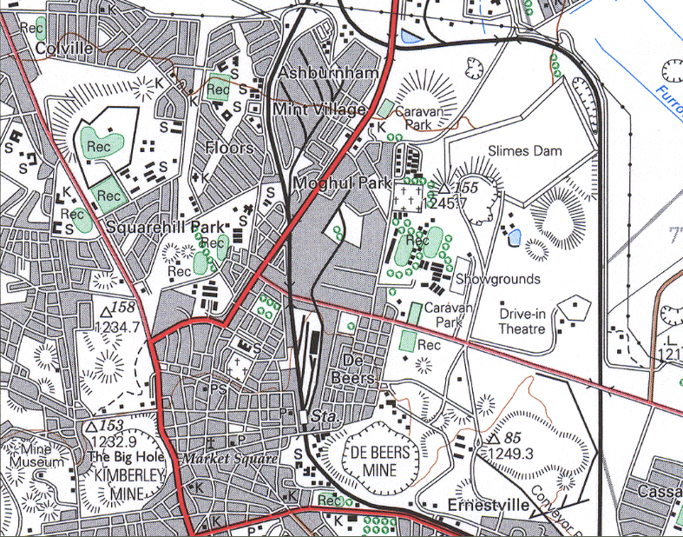

Slide 27
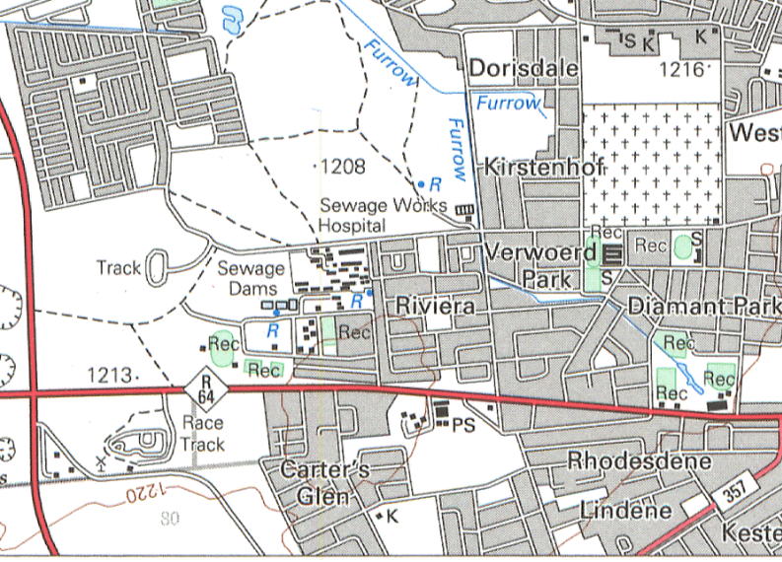

Slide 28
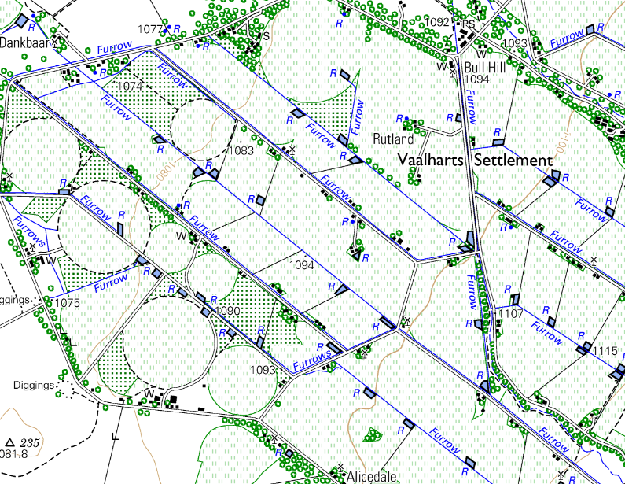

Slide 29
