Slide 1
Geography Paper 2 Revision
Paper 2
Map work
3318DB Paarl Topographic map
3318DB 25 Paarl Orthophoto

Slide 2
Question 1 – Multiple Choice Never leave out questions Write answers in Capital letters Do not write two answers

Slide 3
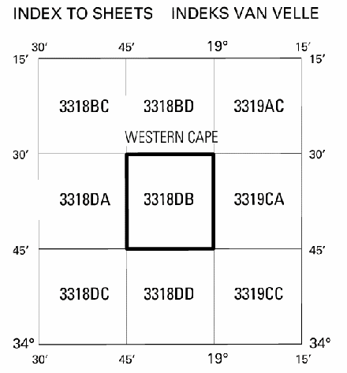
1.1. The index of the map sheet directly southeast of Paarl is …. a. 3319AC b. 3318DC c. 3319CC d. 3318BC
C

Slide 4

1.2. The Earth’s curved surface is represented on the topographic map by the …. projection. a. Transversal b. Lambert c. Mercator d. Gauss conform
D

Slide 5
1.3. Paarl is located in the …. a. Western Cape b. Northern Cape c. Eastern Cape d. Free State
A

Slide 6
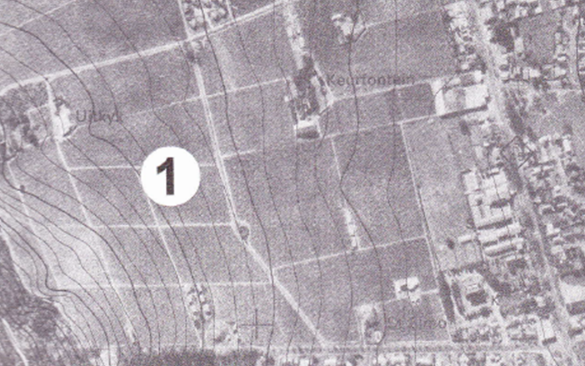
1.4. The approximate time that the orthophoto was taken would be …. a. Between 08:00 – 10:00 b. Between 10:00 – 12:00 c. Between 12:00 – 14:00 d. Exactly at 12:00
C

Slide 7
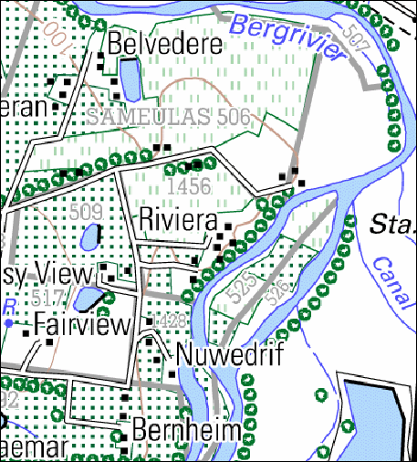
1.5. The stream channel feature in block D12 on the topographic maps is a/an ….. a. Oxbow lake b. Braided stream c. meander d. dendritic pattern
B/C

Slide 8
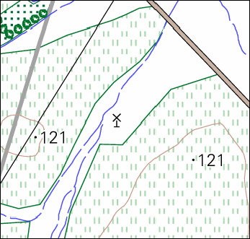
1.6. The manmade feature at 33°38’24”S; 18°52’48”E / 33°38,4’S; 18°52,8’E is a …. a. Dam b. Non perennial river c. river d. windmill (wind pump)
D

Slide 9
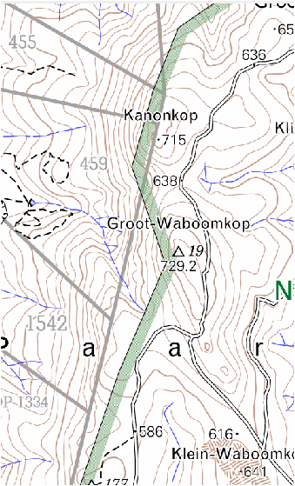
1.7. The drainage pattern in blocks F8, G8 and H8 is a … pattern a. Trellis b. dendritic c. rectangular d. radial
B/D

Slide 10
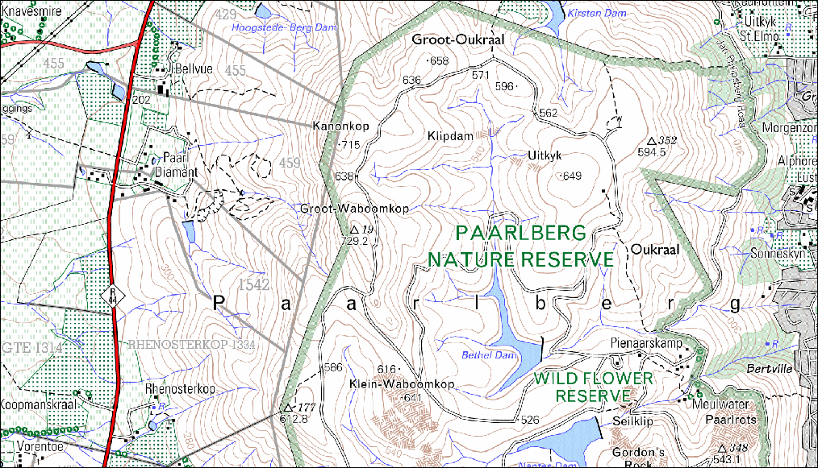

Slide 11
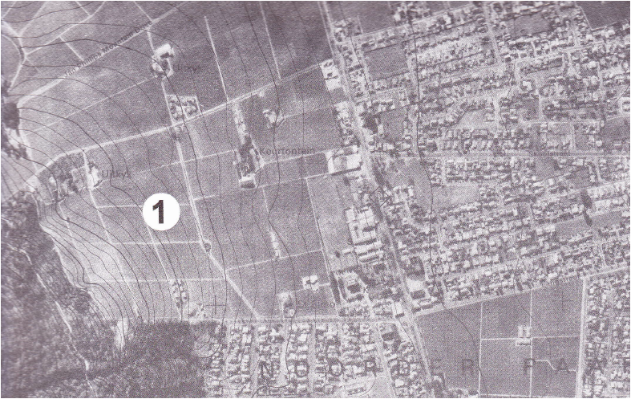
1.8. The land-use zone marked 1 on the orthophoto map is the / a a. zone of decay b. Rural-urban fringe c. high income residential area d. industrial area
B

Slide 12
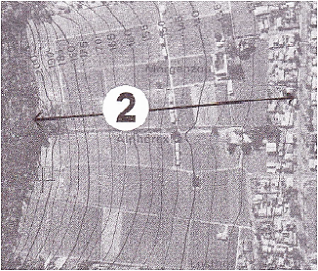
1.9. The slope marked 2 on the orthophoto map is … a. steep b. gentle c. concave d. convex
C

Slide 13
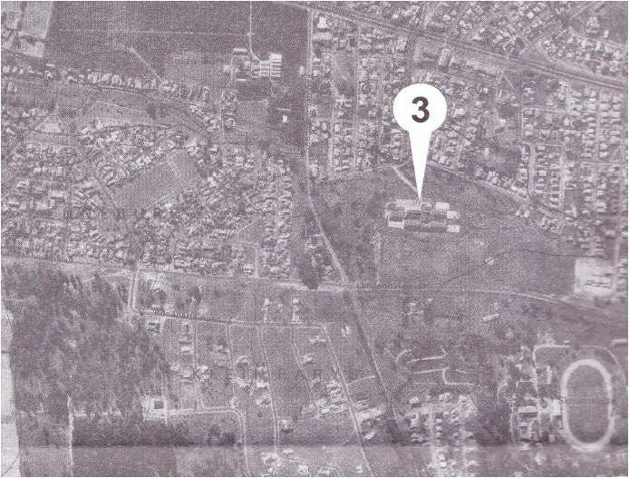
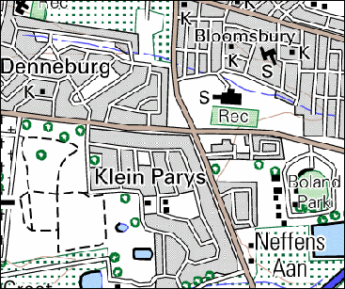
1.10. The building marked 3 on the orthophoto map is … a. school b. factory c. silo d. smallholding
A

Slide 14
Question 2 Geographical techniques and calculations

Slide 15
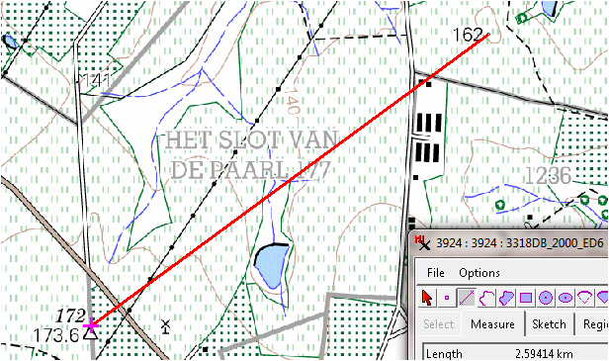
2.1. Calculate the gradient between trigonometrical station 172 in block C8 and spot height ·162 in block B9. Show ALL calculations. Marks will be allocated for calculations.

Slide 16
2.1.
Gradient= VI √ OR Gradient = VI √
HE HE
VI = 173,6 – 162 VI = 173,6 – 162
= 11.6 m√ = 11,6 m√
HE = 52 mm√ x 50 000 HE = 5,2 cm√ x 500
= 2 600 m√ = 2 600 m√
VI = 11,6 ÷11.6 VI = 11,6
HE 2 600 ÷ 11.6√ HE 2600√
1 : 224,13√ 1 : 224,13√
(Range: 215.51 to 232.75) (Range: 215.51 to 232.75)
(6)

Slide 17
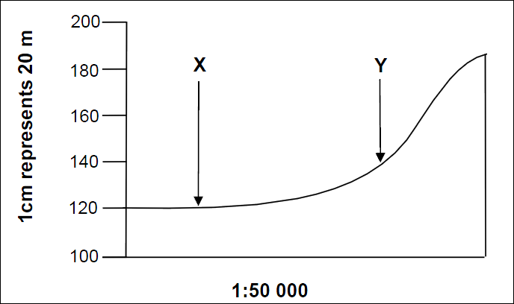
2.2. The following is a cross section from the windmill (block E4) to trigonometrical station 184 (block E6).

Slide 18
2.2.1. Calculate the vertical exaggeration of the cross section above.
VS = 1 cm to 20 m = 1 : 2 000 √
HS = 1 : 50 000 √
VE = VS
HS√
VE = 1 X 50 000
2 000 1
= 25 times √
(Give full marks for the answer) (4)

Slide 19
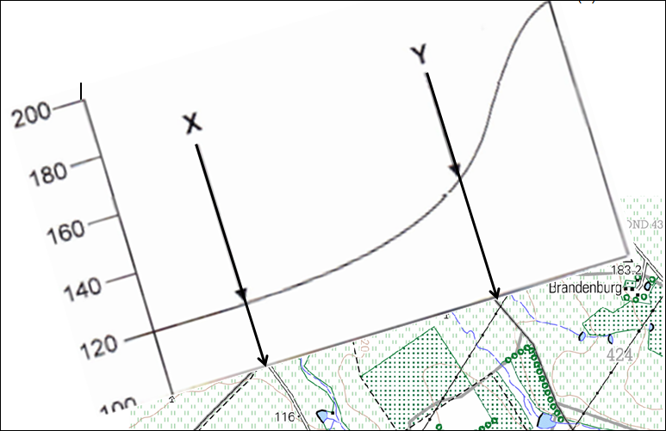
2.2.2. Identify the features labelled X and Y on the cross section

Slide 20
2.2.2.
X: other road / dirt (gravel) road / cultivated land √
Y: power line / cultivated land / farm boundary √ (2)

Slide 21
2.2.3. Why are cross sections exaggerated?
To see the difference in height √ [Concept] (1)

Slide 22
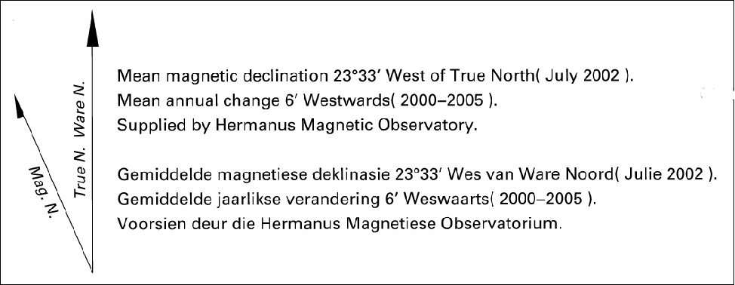
2.3 Calculate the magnetic declination for the year 2011. Show ALL calculations. Marks will be allocated for calculations.
Difference in years = 2011- 2002
= 9 years √ x 6′ W √
= 54′ W √
Magnetic declination in 2011= 23°33′ + √ 54′W
= 23°87′W
= 24°27′W √ (5)

Slide 23
2.4. Give TWO reasons why the magnetic declination will be useful to a person using a map on a field trip.
It will allow the map to be set for accurate orientation √
It determines true north √
To calculate magnetic bearing √
Reaching a destination using a compass √
[Any TWO] (2)

Slide 24
Question 3: Application of Theory / Map and photo interpretation

Slide 25
3.1. Refer to both the topographical map and the orthophoto map when answering the questions below. 3.1.1. Identify the shape of the town Paarl.
Linear √√
Elongated √√
[Any ONE] (1 x 2) (2)

Slide 26
3.1.2. Name TWO physical factors that determine the shape of the town Paarl.
The town developed along the river / berg river √√
The town developed along the mountain range / next to a
steep slope √√
Follows a valley √√
[Any TWO] (2 x 2)(4)

Slide 27
3.2. What is the direction of Boland Agricultural College in block C7 from Paarl?
NW / WNW √√ (1 x 2) (2)

Slide 28
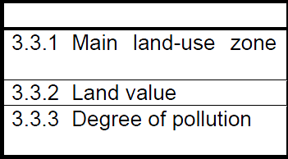
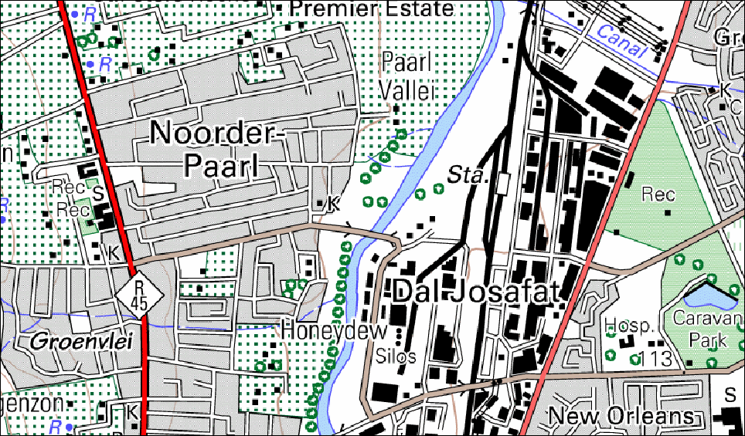
3.2. Compare Dal Josafat (block F12) and Noorder- Paarl (block F11) in terms of the following:

Slide 29
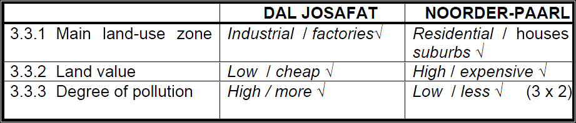

Slide 30
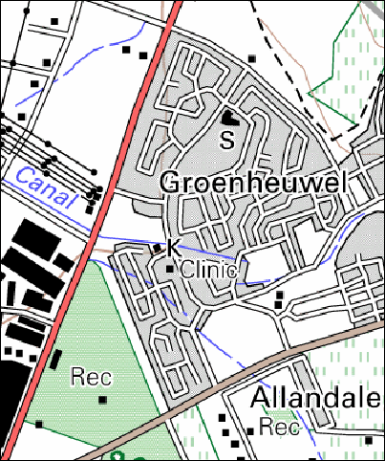
3.4. Refer to Groenheuwel in block E/F13 on the topographical map and marked 4on the orthophoto map.
3.4.1. Identify the street pattern at Groenheuwel.
Planned irregular √√ (1 x 2) (2)

Slide 31
3.4.2. Name ONE advantage and ONE disadvantage of the street pattern identified in QUESTION 3.4.1.
Advantage: Free flow of traffic / less traffic jams √√
More scenic / aesthetic / not boring √√
Follows contours √√
Saves petrol √√
Saves time √√ [Any ONE]
Disadvantage: Get lost easily √√
Lost people will be vulnerable to crime √√
Difficult to develop infrastructure √√
Difficult to expand / layout √√
Many cul-de-sacs √√ [Any ONE] (2 x 2) (4)

Slide 32
3.4.3. The area Groenheuwel (marked 4) on the orthophoto map is a low income residential area. Give TWO pieces of evidence from the orthophoto map to prove this statement.
Small stands √√
Small houses √√
Houses are of the same style / shape / design √√
Close to the industries √√
No vegetation / few trees √√
High density / clustered √√
Many foot paths leading to surrounding areas √√
[Any TWO] (2 x 2)

Slide 33
3.5. Paarlberg in block F/G/H 8/9/10 isan example of a volcanic intrusive landform exposed above the Earth'ssurface after erosion. Refer to both the topographical map and orthophoto map when answering the questions that follow.
3.5.1 State the rock type that results from volcanism before it has been exposed above the Earth's surface.
Igneous / Granite √√ (1 x 2) (2)

Slide 34
3.5.2. Identify the landform referred to after it has been exposed above the Earth's surface.
Dome / bornhardt / ruwari √√ (1 x 2) (2)
3.5.3. Of what potential value is the Paarlberg feature likely to be to the economy of Paarl?
Tourism / nature reserve √√
Abseiling √√
Future mining √√
Farming when it weathers √√
Provide building material √√
Water supply √√
Recreation √√
Job creation √√ [Any ONE] (1 x 2) (2)

Slide 35
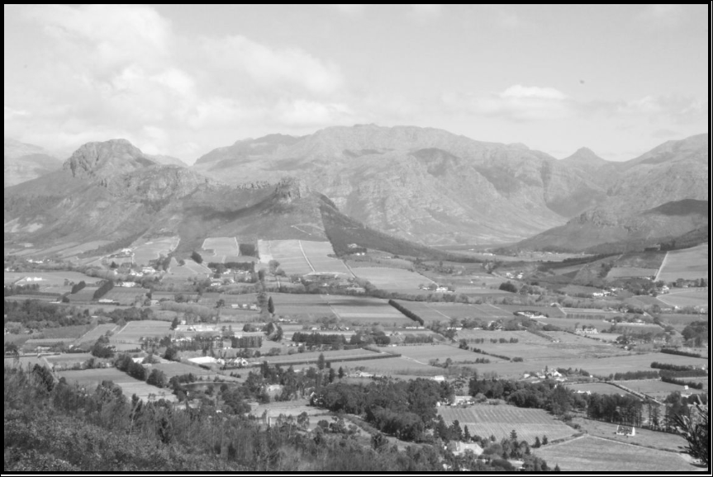
3.6. Study the photograph of the Paarl Valley below, as well as on the topographical map (block F12).

Slide 36
3.6.1. What type of photograph is the photograph of the Paarl Valley?
Horizontal / High oblique √√ (1 x 2)(2)
3.6.2. Identify the slope wind that people in the valley are likely to experience in the evenings in winter.
Katabatic / downslope / gravitational wind √√ (1 x 2)(2)

Slide 37
3.6.3. Would you recommend any industrial development to take place in the Paarl Valley? Explain your answer
No √√
Because pollution will be trapped by the inversion layer √√
Air / water pollution √√
People will experience respiratory problems √√
Acid rain will destroy the vegetation √√
OR
Yes √√
Flat land √√
Access to raw material √√
Availability of water √√
Enough labour √√
[Any ONE. Accept other justifiable reasons] (2 x 2)(4)

Slide 38
3.7. Name ONE factor visible on the topographical map that indicates that nature conservation is important to the inhabitants of the Paarl.
Paarlberg Nature Reserve √√ Wild Flower Nature Reserve √√
Protected areas / firebreaks √√
[Any ONE] (1 x 2) (2)

Slide 39
Question 4: GIS

Slide 40
4.1. Data manipulation is used to control how features are represented on small and large-scale maps.
4.1.1. Explain the meaning of the term data manipulation.
The process used to organise data for your
4.1.2. Explain why it is necessary to manipulate data on maps.
To make changes during data analysis √√
To convert, re-arrange or analyse data to get answers √√
To remove unnecessary information √√
To add any additional information √√
Where different projections are used you should be able to print maps with the same projection √√
[Any ONE of the above- Accept other reasonable answer] (1 x 2)(2)

Slide 41
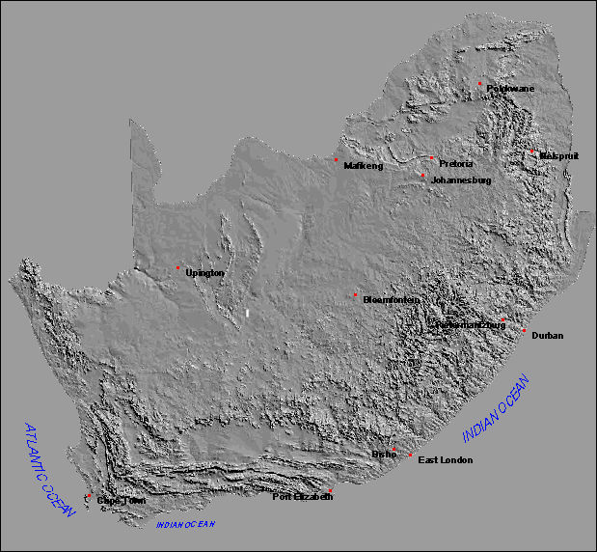
Example 1: Digital Elevation model in shades of grey do not show features and altitude well

Slide 42
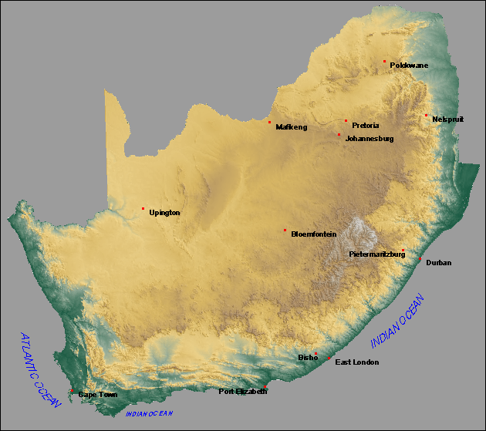
The same information has been manipulated by added colour to the image to illustrate altitude and landscapes better

Slide 43
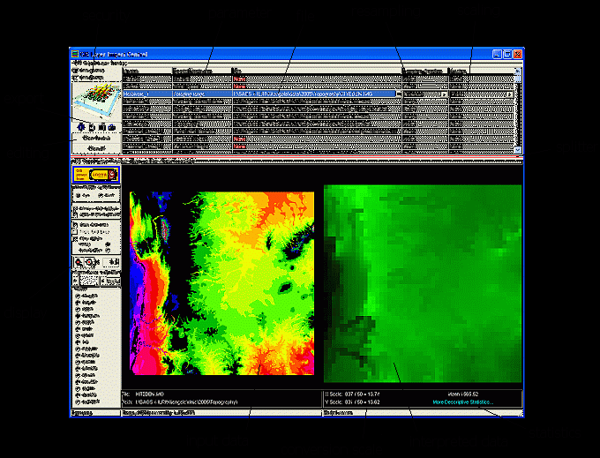

Slide 44
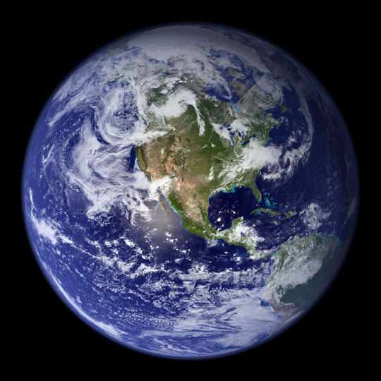
This explains nicely how massive amounts of digital data is manipulated so that we can see it and understand it better. Also look at the different layers of data referred to. Remember that all this data is gathered from remote sensing from satellites with different censors that observe the Earth from a distance.

Slide 45
4.2. Two learners from a school in Paarl have an assignment and have to take photographs of the Berg River. One has a 2, 0 megapixel camera and the other has a 3,5 megapixel camera. The resolution of the photographs taken by the boys will differ.
4.2.1 Explain the meaning of the term resolution.
It refers to the degree of detail and clarity of an image. √√
[Concept] (1 x 2) (2)
4.2.2. Which one of the cameras will take better quality pictures? Explain your answer.
The one with 3,5 megapixels √√
Because it is a higher resolution camera √√
Higher definition / better definition √√
More squares per unit area √√
Larger pixels which lead to clear picture √√
[Any TWO of the above] (2 x 2)(4)

Slide 46
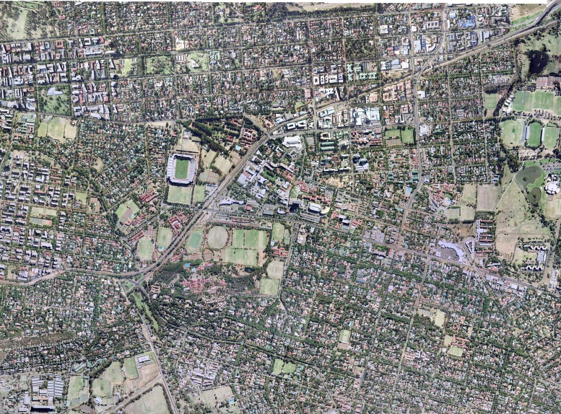
The next three images cover the exact same area in Pretoria, they have the same scale. High spatial resolution photo of Pretoria 15cm by 15cm. Many small pixels give an image with clear detail

Slide 47
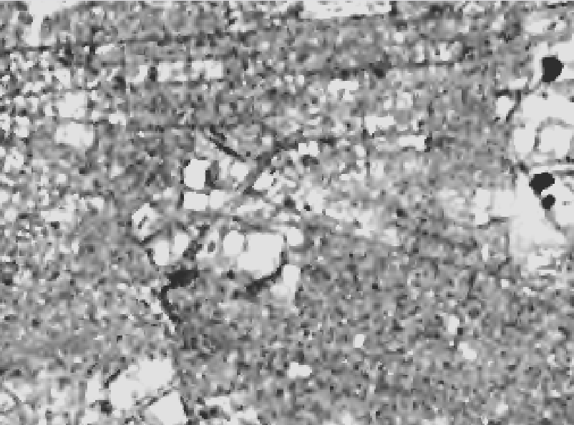
Medium resolution Landsat of Pretoria 15m by 15m Larger pixels reduce the quality of images. The scale did not change.

Slide 48
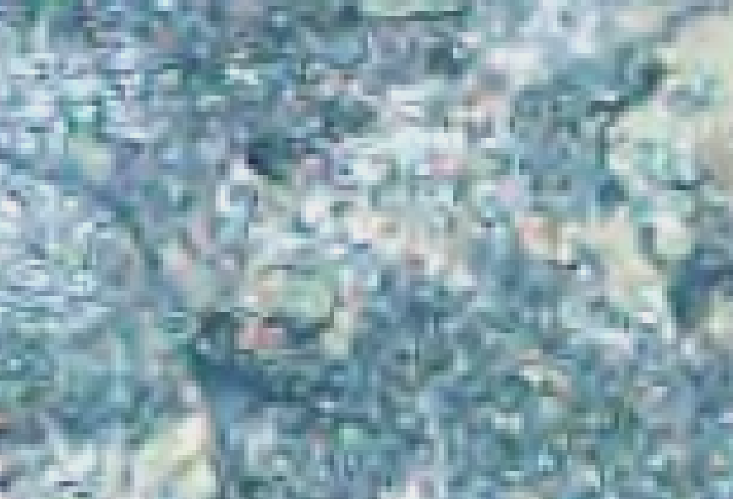
Low spatial resolution image of PTA 30m by 30m. Large pixels render a low quality images, but it takes up less space on a computer hard dive.

Slide 49
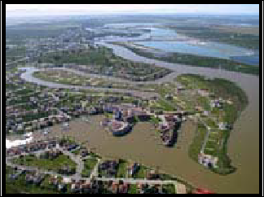
4.3 Heavy rainfall sometimes results in flooding along the Berg River, as is evident in the image below. How could the local government use GIS to manage this disaster?

Slide 50
4.3.
The government could have used GIS in predicting floods √√
Planning should have been done on how to control floods √√
Communicate the occurrence of floods to the inhabitants √√
GIS could enable the government to distribute information to the disaster management centres √√
Use GIS to create a buffer zone around the river √√
[Any TWO of the above – Accept other reasonable answer] (2 x 2)

Slide 51
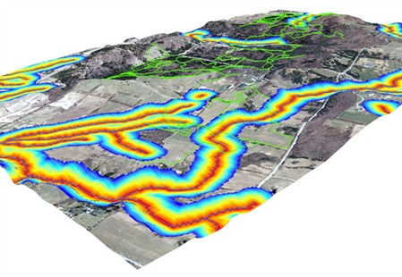
4.4. Urbanisation has a negative impact on rivers. How will buffering prevent the mismanagement of the Berg River?

Slide 52
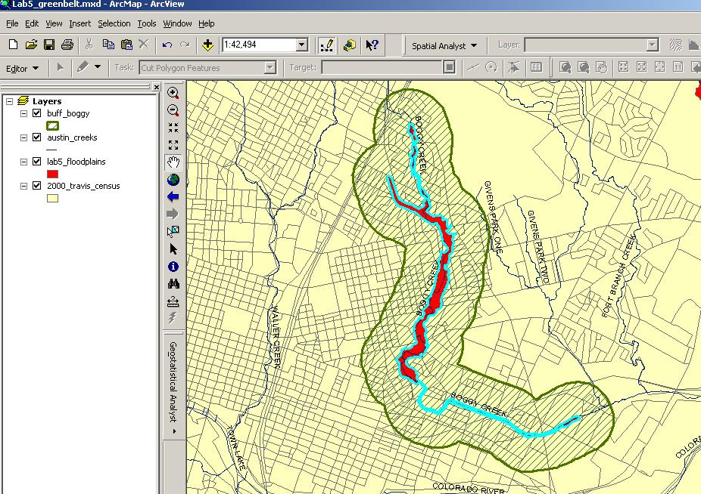

Slide 53
4.4.
Indicates where no agriculture and industries can be located. √√
Prevent pollution from pesticides and industrial wastes being deposited. √√
Leave areas clear for urban expansion. √√
Conserve natural areas / maintaining green belts. √√
[Any TWO of the above] (2 x 2)(4)

Slide 54
4.5. Why are map projections important for the users of GIS?
Has an influence on the level of distortion on a map / image √√
Accurate calculation of areas √√
Choosing the correct map / image for a particular purpose √√
To know whether certain area are exaggerated or shrunk √√

Slide 55
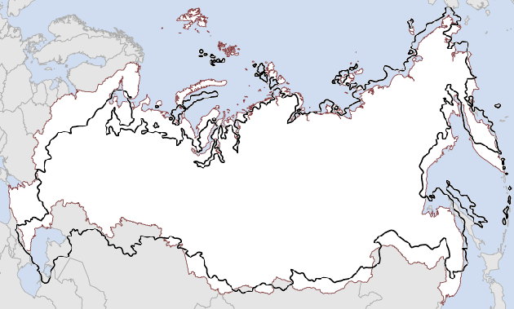

Slide 56
Indicates where no agriculture and industries can be located. √√
Prevent pollution from pesticides and industrial wastes being deposited. √√
Leave areas clear for urban expansion. √√
Conserve natural areas / maintaining green belts. √√

