Slide 1
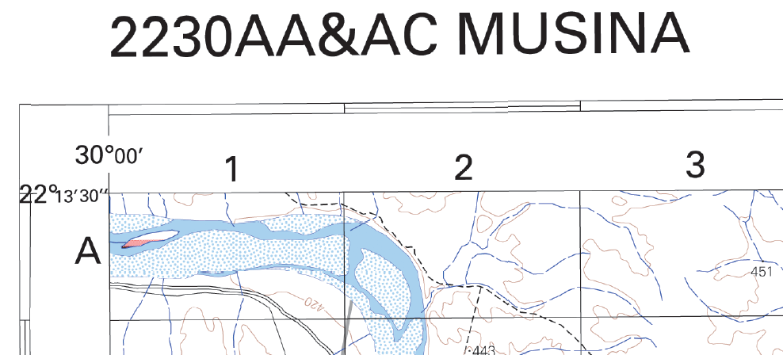
MAPWORK REVISION
MULTIPLE CHOICE QUESTIONS
15/75 Marks (20%)

Slide 2
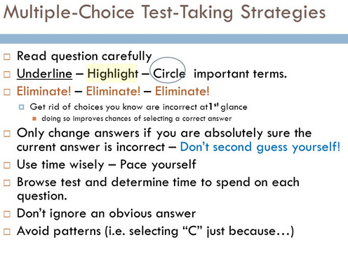
HINTS
Question 1
Answer all the questions – do not leave an answer open
Write clear CAPITAL letters
Don’t write down TWO answers at one question
Work out a number of multiple choice questions from different papers. These question often repeat themselves and you should get good marks for Question 1

Slide 5
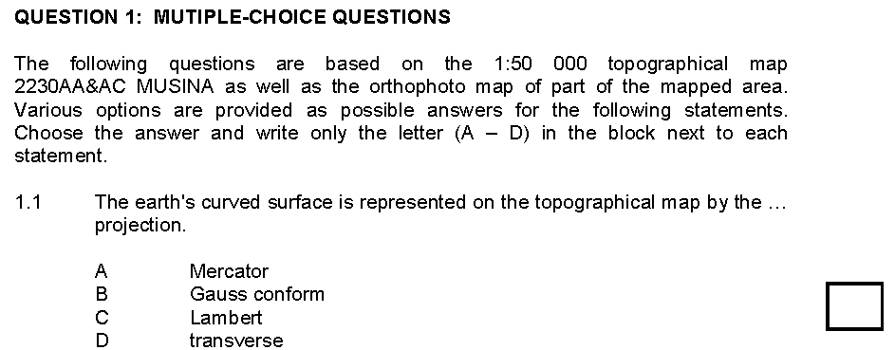
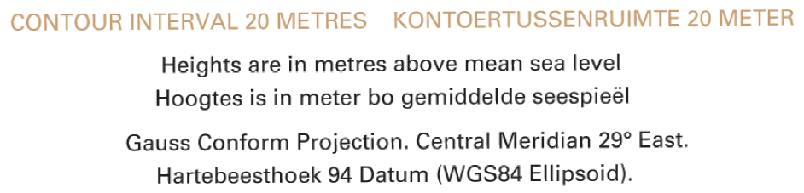
✓

Slide 6
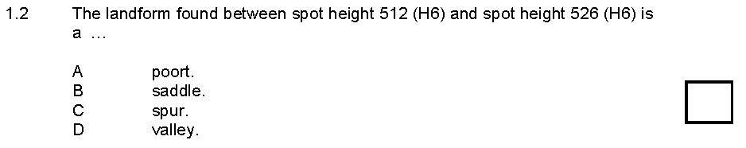
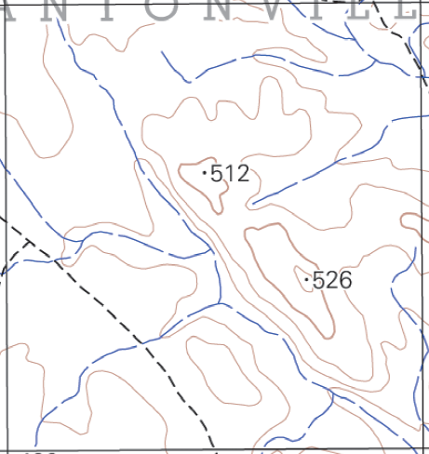
✓

Slide 7
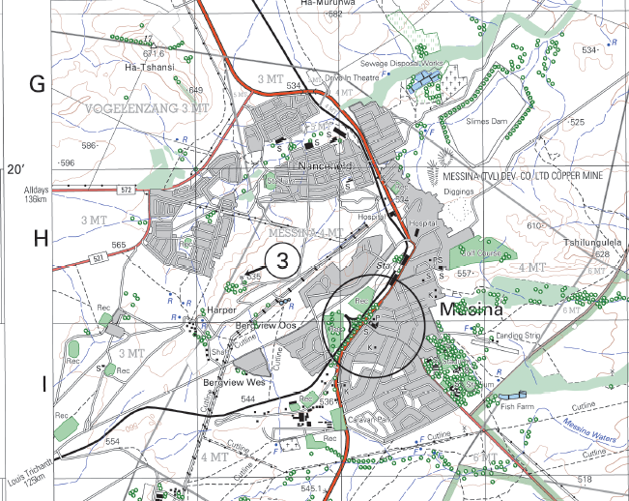
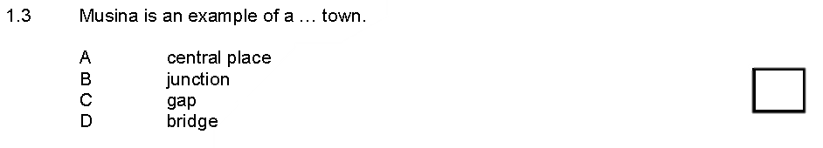
✓

Slide 8
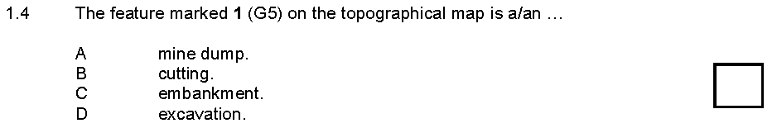
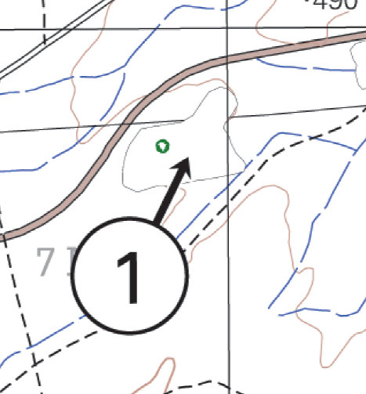
✓
fenced area.

Slide 9
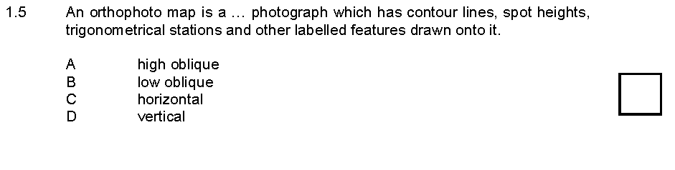
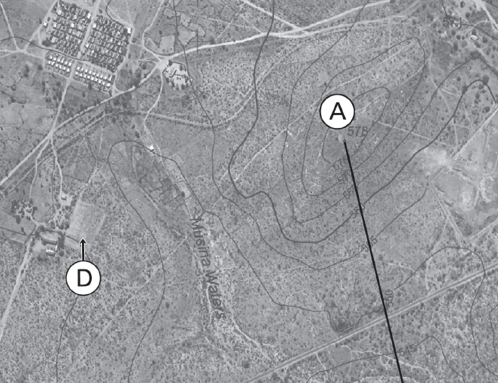
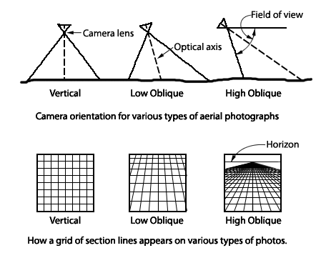
✓

Slide 10
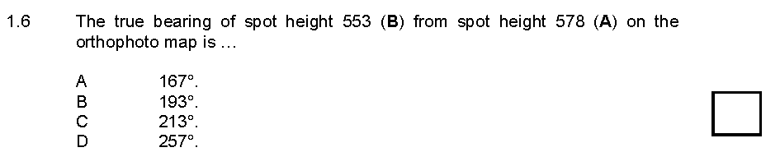
✓
Click here to see how to measure bearing
Click here to go to next question

Slide 11
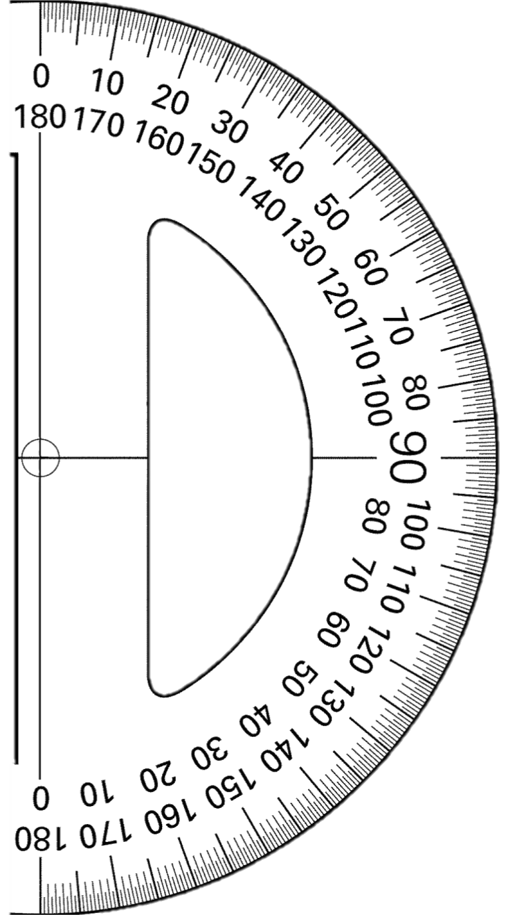
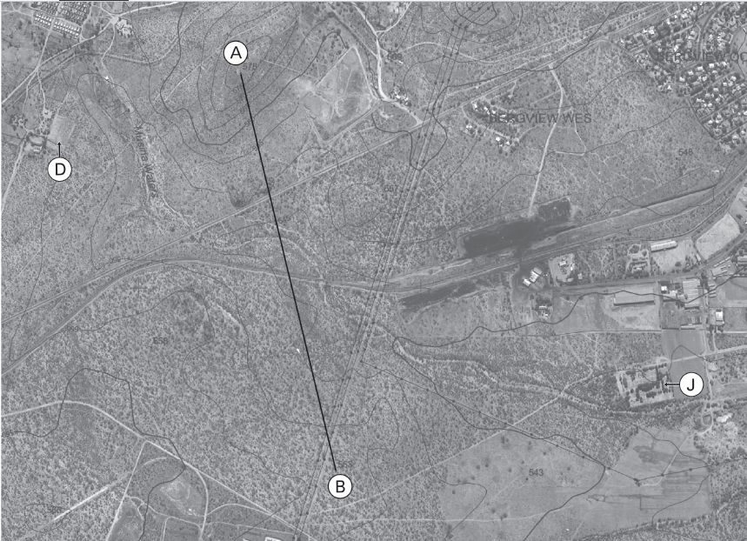
270º
90º
Click here to go back to question
167º
180º

Slide 12
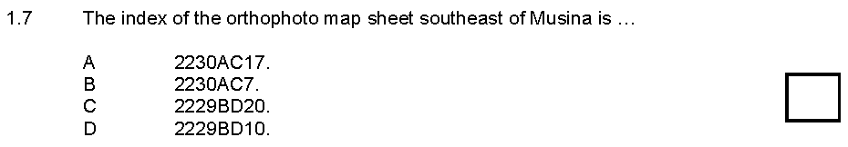
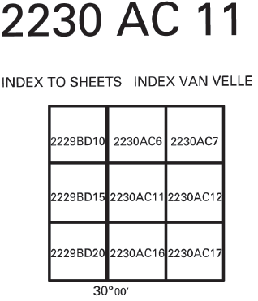
✓

Slide 13
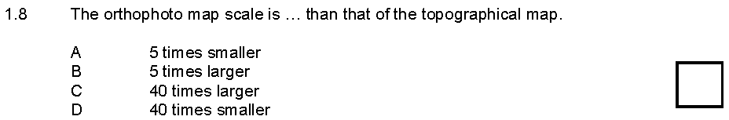
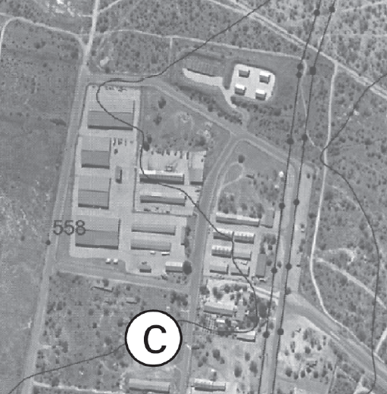
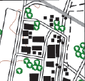
✓

Slide 14
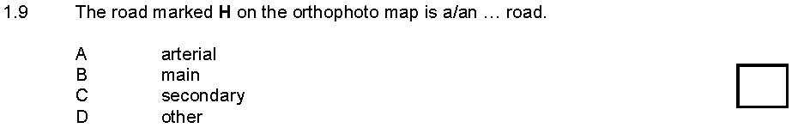
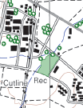
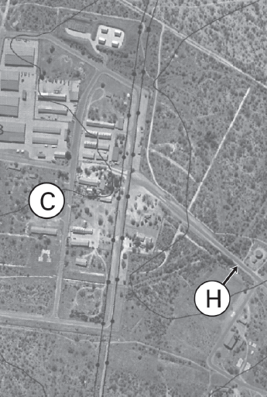
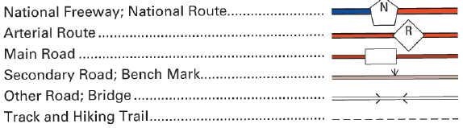
✓

Slide 15
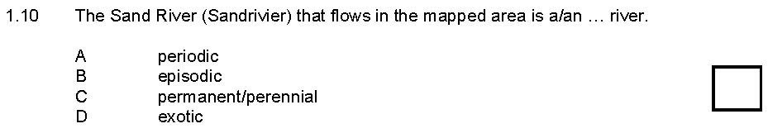
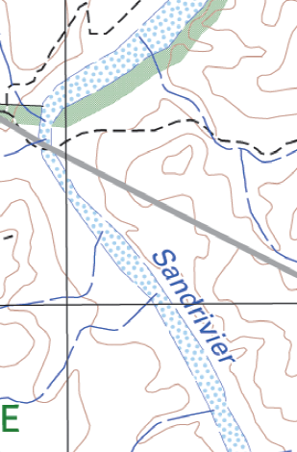
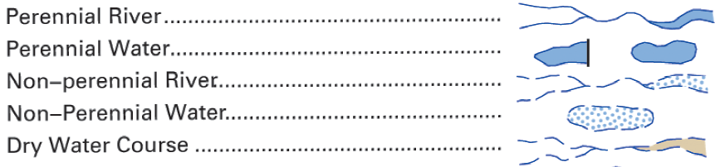
✓

Slide 16
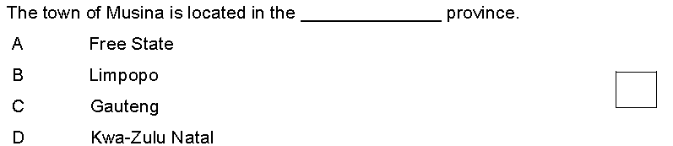
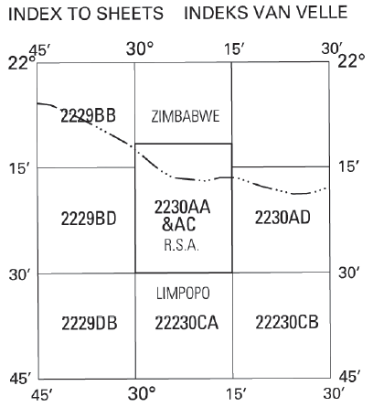
1.11
✓

Slide 17
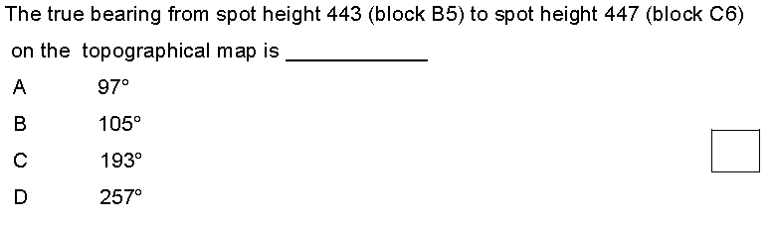
1.12
✓
Click here to see how to measure bearing
Click here to go to next question

Slide 18
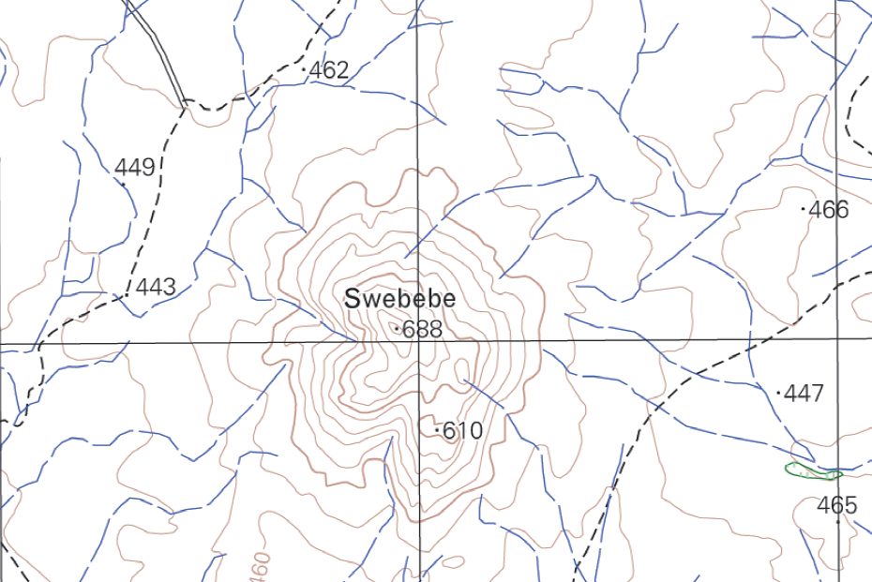
Click here to go back to question
270º
90º
98º
180º

Slide 19
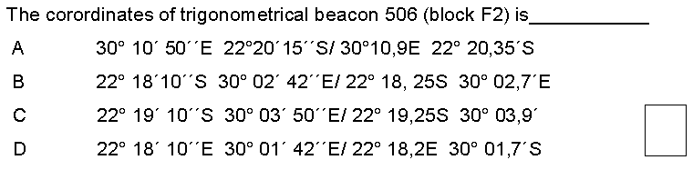
1.13
✓
Click here to see how to estimate coordinates
Click here to go to next question

Slide 20
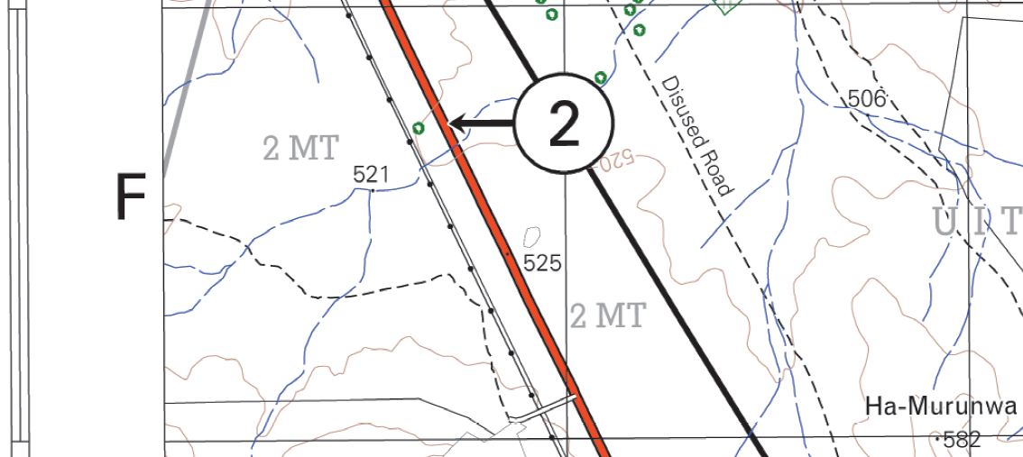
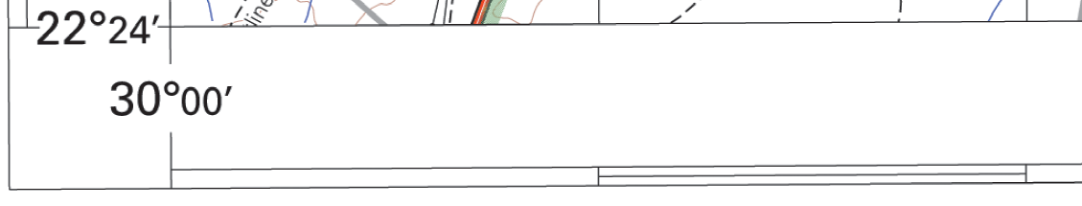
22º18’S
1. Latitude (S)
22º19’S
Click here to go back to question
2. Longitude (E)
30º01’E

Slide 21
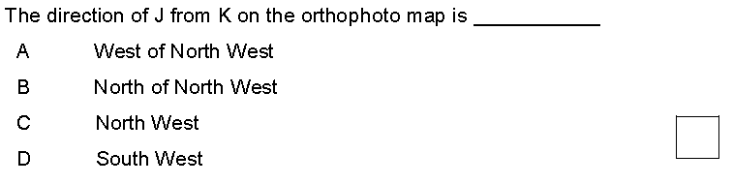
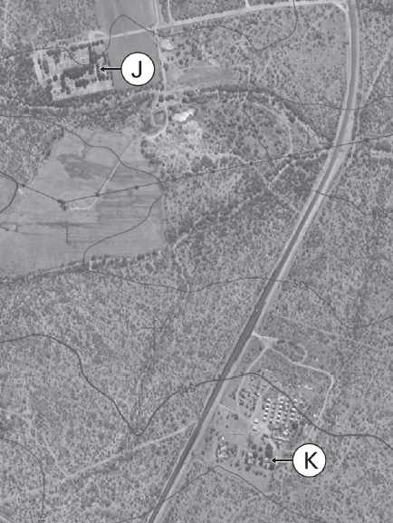
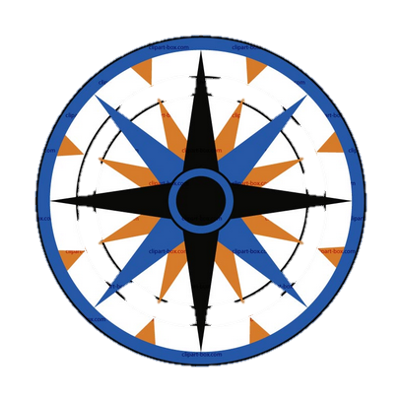
1.14
✓

Slide 22
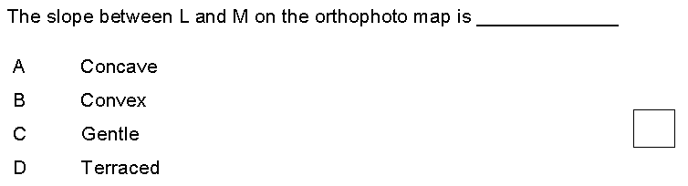
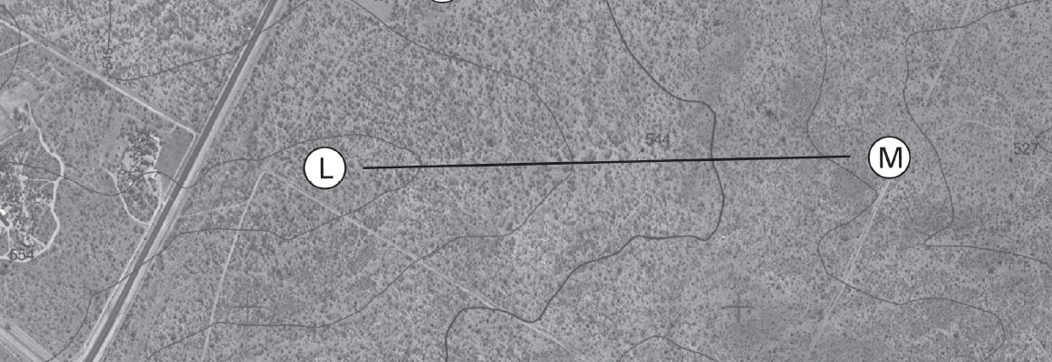


1.15
✓

Slide 23
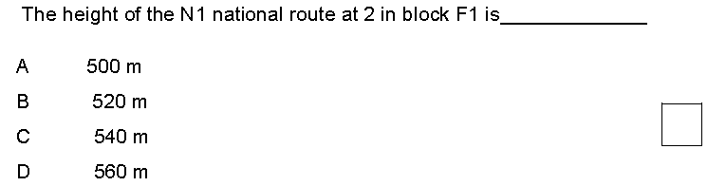
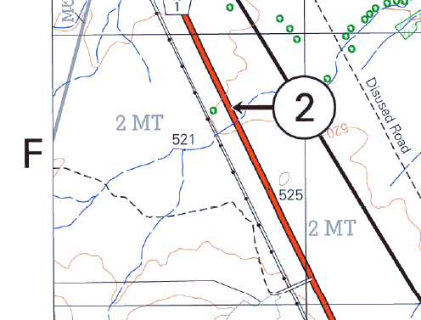
1.16
✓

Slide 24
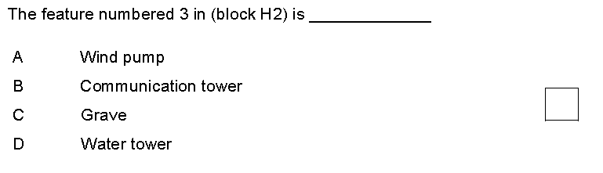
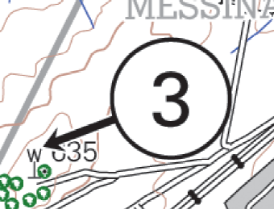
1.17
✓

Slide 25
1.18 The map reference of the map North West of the Musina map is …..
A 22230CD
B 2229DB
C 2229BD
D 2229BB
✓

Slide 26
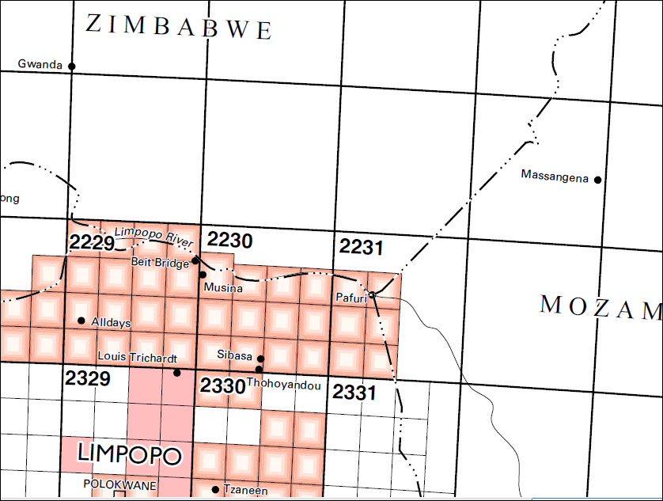
1.19 The ... River forms the boundary between South Africa and Zimbabwe.
A Gariep
B Tugela
C Limpopo
D Pafuri
✓

Slide 27
1.20 The town of ... Is located at the international boundaries between Zimbabwe, Mozambique and South Africa.
A Musina
B Pafuri
C Sibasa
D Massangena
✓

Slide 28
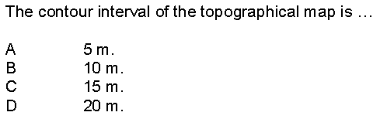
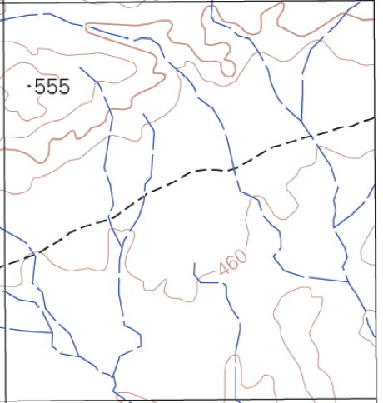
1.21
✓
540m
520m
500m
480m
460m

Slide 29
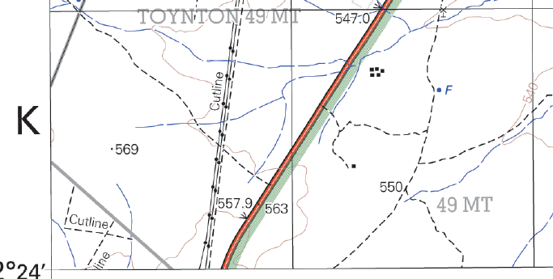
1.22 The difference in altitude between the two benchmarks along the N1 in block K1 and K2 is …
✓
A 10.9m
B 16m
C 3m
D 22m

Slide 30
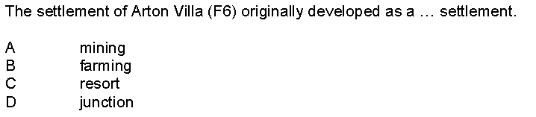
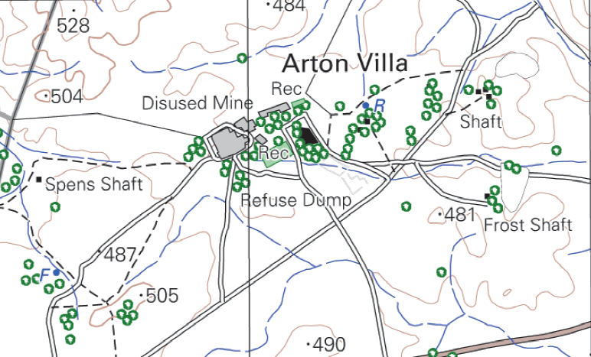
1.23
✓

Slide 31


1.24
✓

Slide 32

1.25
✓

Slide 33



1.26
✓

Slide 34


1.27
✓

