Slide 1
HUMAN IMPACT ON THE ENVIRONMENT

Slide 2
Organisms interact with other organisms and with the environment.
When we, as humans, interact with the environment to satisfy our needs, we may have many negative impacts on the environment through our activities.
We may pollute the land, the water and the atmosphere.
We also make demands on the earth to ensure our food security.
In doing all of this we may impact negatively on the biodiversity of our planet.

Slide 3
THE ATMOSPHERE AND CLIMATE CHANGE
Climate refers to the long-term weather conditions of an area.
The atmosphere is made up of nitrogen, oxygen and other gases, which include the greenhouse gases such as carbon dioxide and methane.
Greenhouse gases absorb long wave radiation emitted from the Earth and prevent it from escaping back into the atmosphere.
This is known as the ‘greenhouse effect’.

Slide 4
THE ATMOSPHERE AND CLIMATE CHANGE
The greenhouse effect is important in keeping the Earth warm so that it can sustain life.
However, an increase in the concentration of greenhouse gases leads to the ‘enhanced greenhouse effect’.
As a result, there may be a significant rise in the average temperature of the surface of the Earth over a period of time.
This is known as ‘global warming’.

Slide 5
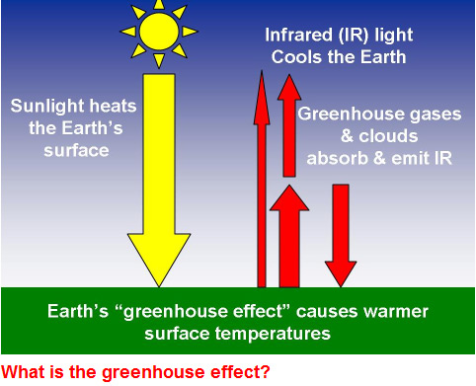
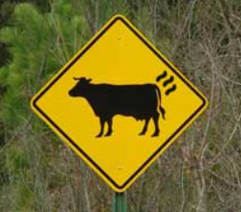
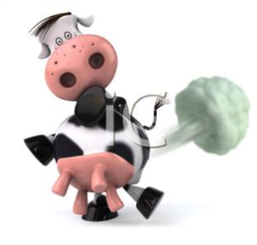
Main greenhouse gases:
Carbon dioxide
Water
Methane

Slide 6
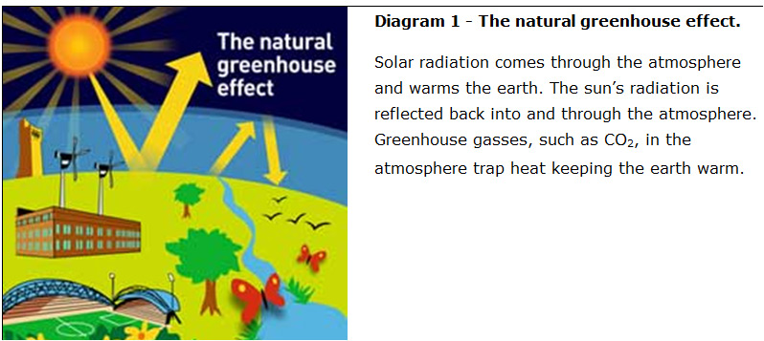
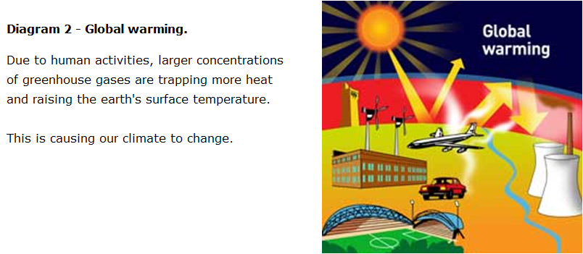
http://www.epa.gov/climatechange/kids/basics/index.html

Slide 7
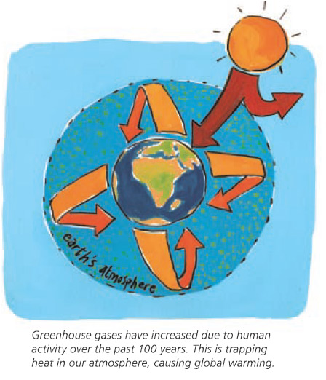

Slide 8
THE ATMOSPHERE AND CLIMATE CHANGE
Increased concentration of carbon dioxide in the atmosphere is due mainly to:
Burning of fossil fuels (for electricity, to power vehicles and for industrial processes): Combustion of carbon-rich fuels such as coal or plants (wood) releases carbon that was stored in them, as carbon dioxide.
Deforestation: Cutting down of trees and removing vegetation from the land decreases the amount of carbon dioxide taken up by plants during photosynthesis. This increases the amount of carbon dioxide available in the atmosphere.

Slide 9
THE ATMOSPHERE AND CLIMATE CHANGE
Increased concentration of the methane in the atmosphere is due mainly to:
The expansions of rice agriculture and increased number of landfills: decay of organic matter in waterlogged soils such as rice paddies and landfills releases methane
The increased number of livestock: ruminants such as cows release methane gas through their digestive tracts
Mining of coal

Slide 10
THE ATMOSPHERE AND CLIMATE CHANGE
Increased temperatures may lead to:
More evaporation of water which can lead to increased precipitation which eventually increases the potential of flooding
Rising sea levels caused by melting ice in the glaciers which can eventually increase the potential of flooding
Increased wildfires that increase the chances of soil erosion and eventually desertification
Increased loss of biodiversity as species are unable to cope with rapidly rising temperatures, eventually lead to desertification
Increased droughts in some areas leading to desertification and food insecurity

Slide 11
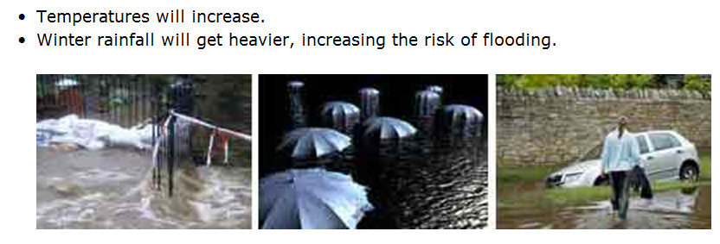
Effects of Climate Change

Slide 12
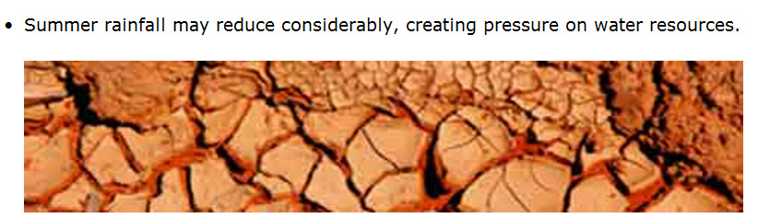
Effects of Climate Change

Slide 13
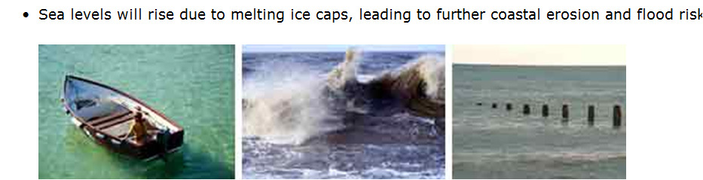
Effects of Climate Change
http://www.epa.gov/climatechange/kids/
Research what individuals, schools, communities and businesses can do to reduce climate change

Slide 14
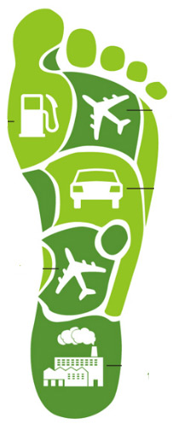
Carbon footprint: the amount of carbon dioxide or other carbon compounds emitted into the atmosphere by the activities of an individual, company, country.

Slide 15
THE ATMOSPHERE AND CLIMATE CHANGE
Carbon footprint
This is a measure of the total amount of greenhouse gas emissions of an individual, a defined population or a company per year.

Slide 16
THE ATMOSPHERE AND CLIMATE CHANGE
Strategies to reduce the carbon footprint include the following:
Reuse and recycle – less fossil fuels burnt in the production of some of the material
Drive less – by using public transport, walking, bicycles
Reduce the need for heating by insulating walls and building energy efficient homes
Carbon offsetting – by using alternative energy (solar and wind) and reforestation to act as a carbon reservoir.
Technological developments – decrease the amount of energy needed for production/decreasing the dependency on carbon emitting fuels

Slide 17
THE ATMOSPHERE AND CLIMATE CHANGE
Destruction of the ozone layer
Ozone is a greenhouse gas that is found at low concentrations 15 – 50km above the Earth’s surface. It absorbs the ultraviolet rays from the sun. The ultraviolet rays damage the DNA and cause skin cancer. Measurements in certain areas have shown a significant decrease in the amount of ozone layer. The damage of the ozone layer is caused mainly by the chemicals called CFCs (chlorofluorocarbons), released by the refrigerators, aerosol sprays and fast-food packaging.
If the measures to reduce the destruction of ozone layer fail:
There will be a significant increase in the number of skin cancer cases
Ultraviolet rays reaching the Earth’s surface may cause permanent damage to our eyes

Slide 18
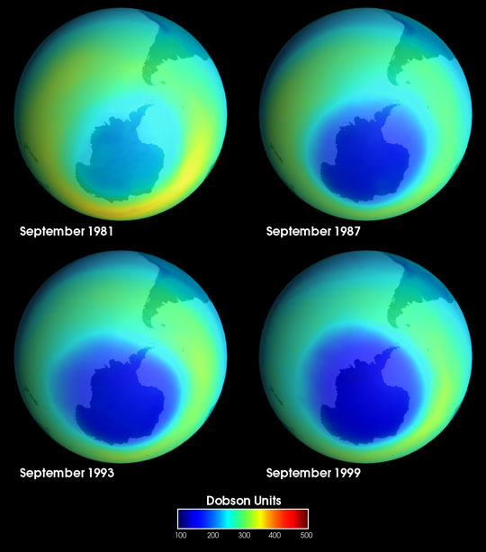
Ozone Hole
These images of the ozone hole were taken by NASA between September 1981 and September 1999.
http://veimages.gsfc.nasa.gov/138/ozone_hole.jpg

Slide 19
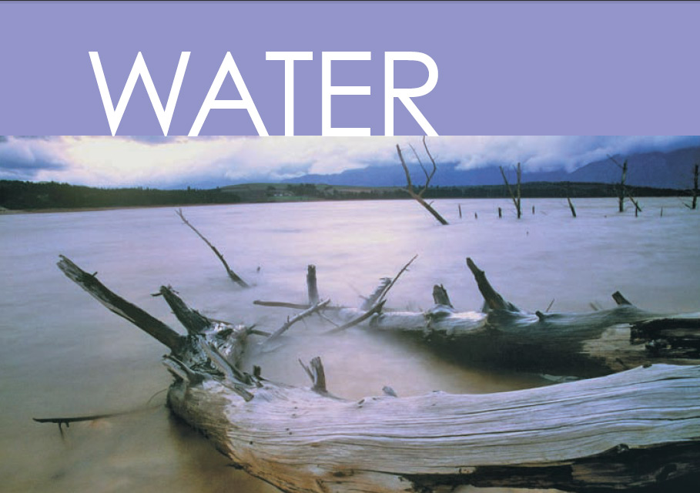

Slide 20
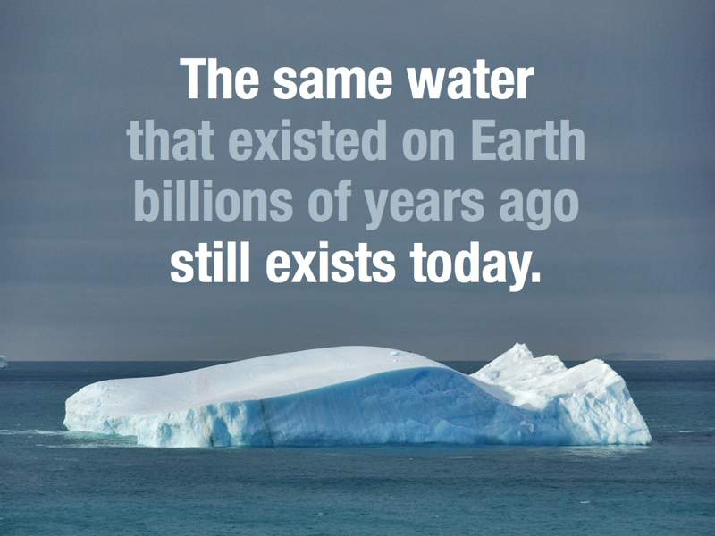

Slide 21
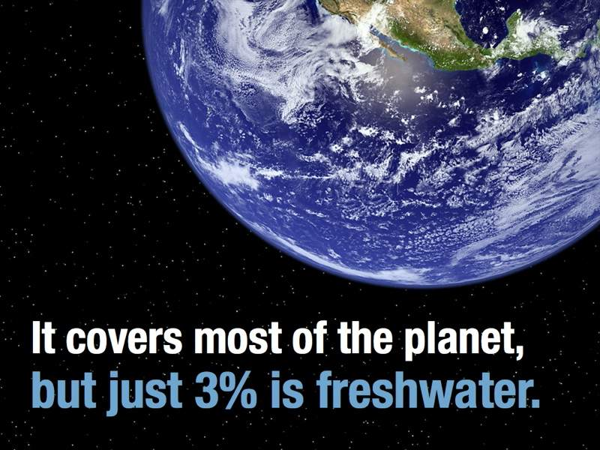

Slide 22
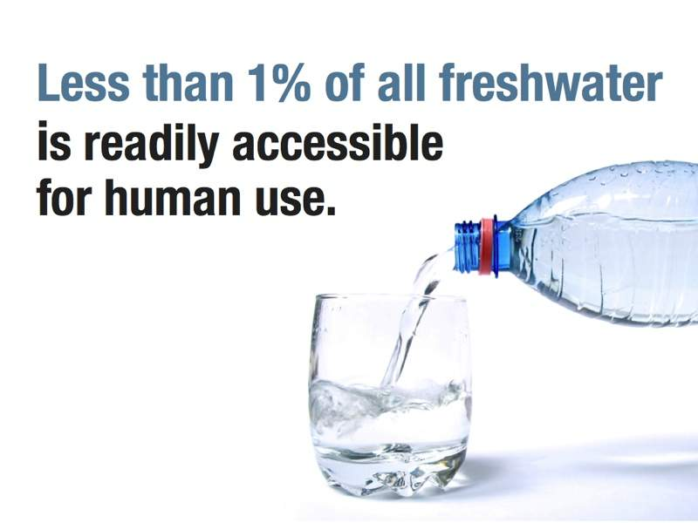

Slide 23
Water Quality and Water Availability
It is estimated that as many as 2 billion people won’t have sufficient access to clean water by 2050.
This figure is expected to rise to 3.2 billion by 2080 — almost three times the number of people who now do without water.
There are many efforts directed towards making good quality water available.

Slide 24
Water Quality and Water Availability
Availability of water
The availability of water may be influenced by the following factors

Slide 25
Water Quality and Water Availability
Construction of Dams
The construction of additional dams play a major role in increasing the quantity of water stored and made available for later use by people and in agriculture.

Slide 26
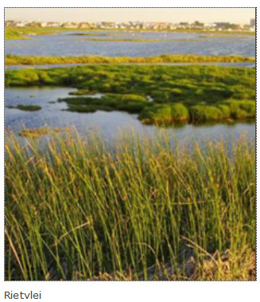
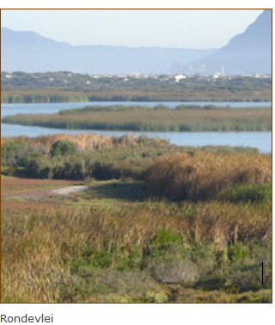

What is a wetland?
Wetlands are areas where terrestrial and aquatic ecosystems come together.
In a wetland, the water table is at or near the surface of the ground. The land is either temporarily or permanently covered with shallow water.
http://wetlands.sanbi.org/

Slide 27
Water Quality and Water Availability
Destruction of wetlands
Wetlands should not be destroyed because they influence both the availability and quality of water
Wetlands trap and provide water for domestic and livestock use as well as for irrigation.
The vegetation in the wetlands also helps in purifying the water naturally.

Slide 28
Water Quality and Water Availability
Water wastage
A large amount of water used for irrigation is lost due to poor farming practices. Open drain irrigation leads to loss of water by evaporation. The use of water for irrigation further up a river decreases the availability of water for other users lower down in the river.
Availability is also affected by wastage of water through leaking taps and toilets and faulty pipelines.
Wastage of water can be reduced by reducing the pressure in the pipes, by educating people to use water wisely and by maintaining all plumbing in good condition.

Slide 29
Water Quality and Water Availability
Cost of water
The cost of water is influenced by costs involved in increasing the availability and quality of water.
The cost per kiloliter (kl) of water increases with increased use of water. This is meant to discourage over-use of water, thus allowing for its sustained use.
A certain amount of water is available free to all citizens to ensure that water is available to the poorest.

Slide 30
Water Quality and Water Availability
Poor farming practices
Contamination of water sources by fertilizers and pesticides have decreased the amount of clean water available, thus increasing costs involved in purification.
Over-grazing leads to soil erosion. On land that is eroded, water runs off rapidly rather than soaking into the ground, and is thus wasted.

Slide 31
Water Quality and Water Availability
Droughts and floods
During periods of drought, water availability decreases. Water used from the dams during the drought periods cannot be easily replaced.
Natural vegetation can hold back water from floods. If the natural vegetation is removed, flood waters are lost.

Slide 32
Water Quality and Water Availability
Boreholes and its effect on aquifers
Boreholes have been used to increase water availability in areas that do not have direct access to other sources of water.
Constant use of boreholes eventually leads to the drying up of aquifers (the source of borehole water) thus decreasing water availability in the future.

Slide 33
Water Quality and Water Availability
Water recycling
The availability of water can be increased if existing water is used for more than one purpose. For example, some water used in the household can be used for the garden. Sewage water can be treated and used again.

Slide 34
Water Quality and Water Availability
Exotic plantations and the depletion of the water table
Some exotic plants use a large quantity of water from the ground. As a result, this decreases the level of the water table, making less water available to other vegetation in the area.

Slide 35
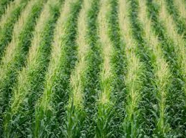
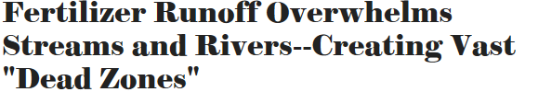
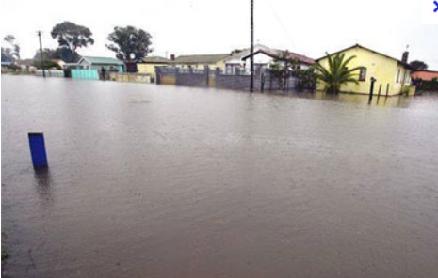
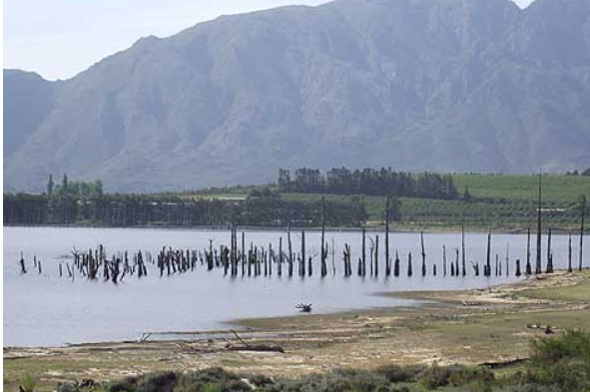
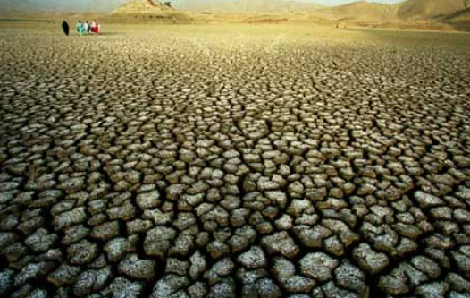
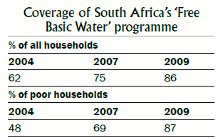

Monoculture
Floods and Droughts
Dams

Slide 36
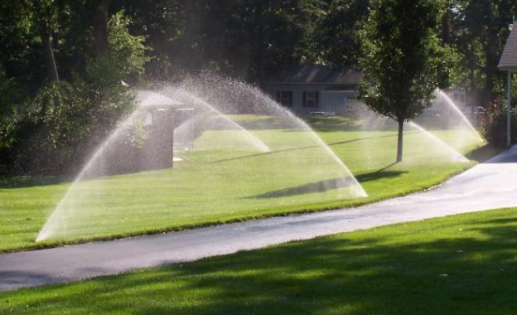
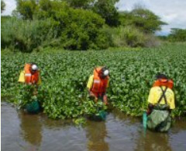
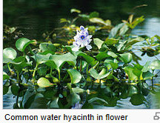
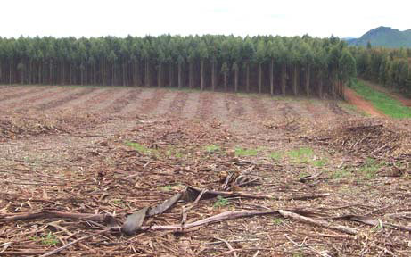
Boreholes and effects on ground water
Invasive alien plants eg
Exotic plantations
Water hyacinth/Eichonia

Slide 37
Water Quality and Water Availability
Quality of water
The quality of water may be influenced by the following factors

Slide 38
Water Quality and Water Availability
Eutrophication and algal bloom
Water used for agriculture my contain pesticides, herbicides and fertilizers which pollute the water in rivers, dams and lakes, causing eutrophication.
The added nutrients lead to an increase in algal growth (algal bloom).
These algae over-use and thus deplete the oxygen in the water, thus reducing the potential for life in such water.

Slide 39
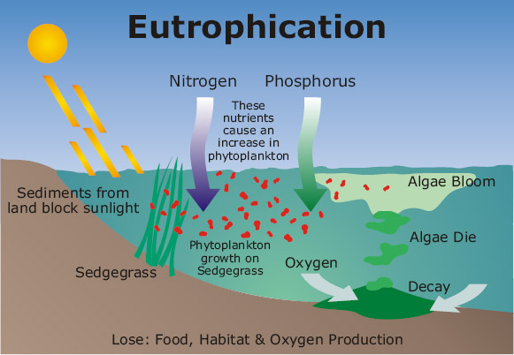

Slide 40
Water Quality and Water Availability
Thermal pollution
Thermal pollution refers to the heating of water caused by the use of water in the cooling of power-stations and in industries.
The quality of water is affected because heated water has a lower oxygen content, making it difficult to support life.

Slide 41
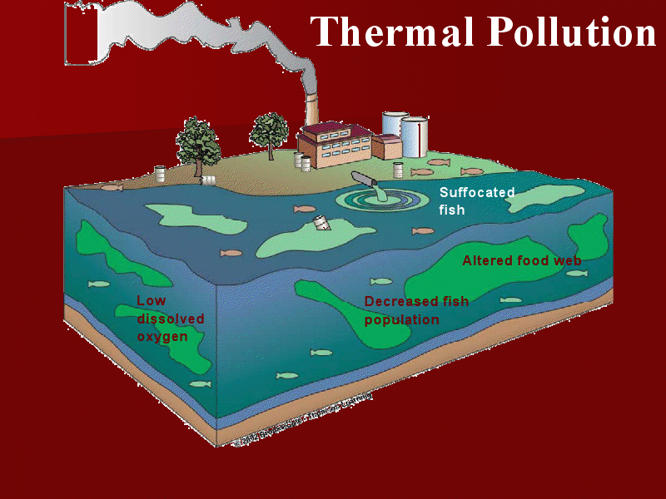

Slide 42
Water Quality and Water Availability
Pollution of water through domestic, agricultural and industrial use
After water is used for domestic purposes it may contain detergents (such as from washing) and pathogenic bacteria (such as in sewage). This polluted water has to be treated before it can be used again.
After water is used for industrial purposes it may contain many heavy metals, oil, heat and fertilizers. This adversely affects the quality of the water and all life that depends on it.
Fertilisers and pesticides may run off into rivers, ponds and dams and pollute the water.

Slide 43
Water Quality and Water Availability
Mining
Water returned to the environment from mines is generally acidic and toxic. This water is hot and thus also contributes to thermal pollution
Alien Plants
Alien invasive water plants block the waterways, reducing light to other aquatic plants. These plants eventually die and decompose. Bacteria that decompose these plants eventually deplete the oxygen supply in the water.
Water purification
The quality of water is improved through purification methods. Undrinkable water can be made drinkable.

Slide 44
Food Security
Food security refers to the access, by all people at all times, to adequate, safe and nutritious food for a healthy and productive life.
Food security may be influenced by the following factors

Slide 45
Food Security
Exponential growth of the human population
The world’s population is growing at an exponential rate (very rapidly) and as a result some countries cannot produce enough food to feed their growing population. Food production needs to increase as rapidly as the world population; otherwise many countries would experience food insecurity.
Droughts and floods
Climate change has led to more frequent and severe droughts and floods. Droughts result in crop losses and livestock death, which reduces the food available in an area. Floods cause extensive damage in a short period of time and decrease the amount of farmland available to grow crops. People also usually lose their homes, possessions and economic security during floods, further impacting on food security.

Slide 46
Food Security
Poor farming practices – monoculture, pest control, loss of topsoil and the need for fertilizers
Monoculture is the growing of one type of crop over large areas of land year after year. Monoculture depletes nutrients and water supplies and therefore impacts negatively on the quality of the topsoil.
Pest control involves the use of pesticides (chemicals) to kill pests that compete with humans for food. Pesticides may kill or get into the tissues of healthy plants. This may reduce crop production and, since pesticides are expensive, increases the cost of food and thus reducing access to poor consumers. Many farmers now use biological control, which uses a natural predator/parasite to get rid of the pest instead of using expensive pesticides.
Topsoil is the top 1,5 metres of soil that contain the nutrients that plants require for growth. The tilling of the soil between plantings and heavy rainfall cause much of the topsoil to be lost, leading to the loss of valuable nutrients over time, reducing crop yields.
The use of fertilizers, both inorganic (chemical) and organic (compost and manure) can increase the nutrients in the soil and keep soil fertile. This replaces nutrients in the soil that is lost when crop plants absorb them. Fertilizers can be expensive, contributing to the high cost of food, thus reducing access to poor consumers.

Slide 47
Food Security
Alien plants and reduction of agricultural land
Alien plants deplete the topsoil of water and nutrients. These alien plants out-compete indigenous plants because they have no natural predators, growing rapidly and invading land that could be used to grow crops.
The loss of wild varieties and its impact on gene pools
Crop plants have replaced wild varieties. The preservation of wild varieties is important because, if changing environmental conditions destroy the present crop plants, then wild varieties could be used as alternative sources of food. If wild varieties get wiped out, it will reduce the genetic diversity and thus the gene pool.

Slide 48
Food Security
Genetically engineered food
Genetically engineered food is produced from genetically modified organisms (GMOs). Genetic engineering involves the inserting of a gene (with a desired characteristic) from one organism into another organism to increase the yield. For example, a gene for drought resistance could be inserted into a crop plant that grows in areas where water is scarce.
Food wastage
Wastage could occur during the storage, production and processing of food. Wastage includes food thrown away and food not eaten. Wastage increases the prices of food to consumers and could reduce food security in a country.

Slide 49
Loss of Biodiversity
Biodiversity refers to the variety of plant and animal species on Earth.
Biodiversity ensures that we have food, fresh water, medicines and fuel that we obtain from our environment.
It also ensures that the climate is regulated, floods are controlled (wetlands), diseases are kept in check (predators eat the sick animals) and water is purified (filtering by wetlands).
Biodiversity ensures that seeds are dispersed, nutrients are cycled (e.g. nitrogen and phosphorus) and oxygen and soil continue to form.
It also helps improve our quality of life by providing us with forms of recreation and ecotourism.
As biodiversity declines, these things do not occur as they should and the survival of humans become threatened.

Slide 50
Factors that Reduce our Biodiversity
Habitat destruction through
Farming methods
Monoculture: Monoculture is the growing of one type of crop over large areas of land year after year. Monocultures replace indigenous plants and reduces biodiversity. Insects that specialise in feeding on one type of crop spread rapidly because there are no natural enemies or barriers to stop them. This means the farmer needs to use more pesticides to kill them. Intensive use of agrochemicals such as fertilisers and pesticides often end up in rivers, streams and groundwater, poisoning species in the area and causing eutrophication. This results in a large loss of biodiversity.
Overgrazing: It occurs when livestock such as sheep or cattle are kept in an area for too long; the vegetation is grazed to a point where it will not grow back. It causes soil erosion by removing the plants that bind the soil together with their roots. Topsoil is lost during rainstorms. This can lead to extensive destruction of land through desertification which results in loss of biodiversity. Sometimes overgrazed land becomes subject to alien plant invaders which destroy habitats by taking over the land.

Slide 51
Golf Estates
Developments such as golf estates are a form of monoculture that require large amounts of water, pesticides and fertilisers which may runoff and poison aquatic ecosystems. Housing associated with golf developments replaces large areas of natural vegetation.
Mining
Mining alters the environment and can negatively affect the biodiversity in an area. Pollutants in the form of dust and smoke may be released into the air while vegetation is removed and replaced with rock and waste dumps. Underground water may be poisoned because of sulphates and heavy metals released into them.
Urbanization
The growth of large cities (urbanisation) also negatively impacts on biodiversity. Surfaces are covered with concrete, and natural habitats are destroyed to build houses and businesses. Habitat fragmentation causes loss of biodiversity, as natural plants are replaced with exotic trees and plants.

Slide 52
Deforestation
Deforestation is the permanent destruction of indigenous forest and woodland areas. Deforestation is caused by human activities such as agriculture, logging, and using trees as firewood. Deforestation leads to the destruction of the habitats of other organisms, like frogs and insects, and this leads to the loss of biodiversity.
Loss of wetlands and grasslands
Grasslands and wetlands have unique plant and wildlife and provide many ecological services to humans. Destruction of these habitats will lead to the loss of species.

Slide 53
Factors that Reduce our Biodiversity
Poaching
Poaching refers to the illegal hunting of animals, either for food or because certain body parts can be sold for money. ‘Poaching’ may also be applied to plants that are removed and sold for profit e.g. medicinal plants. Some wild animals are hunted for food (‘bush meat’) and are on the verge of extinction. Elephants are poached for their tusks to make carvings and jewellery and rhinos are hunted for their horns which are used in the Far East for medicinal reasons.
Alien plant invasions
These plants are species that have been introduced into an area and which compete with the natural plants in the area. They can outcompete indigenous plants, thus reducing the biodiversity.

Slide 54
Ways in which our biodiversity can be maintained
Control of alien plant invasions
Alien invasive species may be controlled by mechanical, chemical and biological methods.
Mechanical methods involve chopping down plants or physically removing them by hand and is very time consuming.
Chemical control involves spraying herbicides on the plants; this can pollute the environment and is expensive.
Biological methods involve introducing a natural enemy from the alien plant’s environment and allowing it to reproduce and feed on the invasive plant

Slide 55
Ways in which our biodiversity can be maintained
Sustainable use of the environment
Sustainable use of the environment means using resources without harming the ability of future generations to use that resource.
Substances from indigenous plants such as the African potato, Hoodia, rooibos and Devil’s claw all have economical and medicinal value.
These indigenous plants can be used sustainably by encouraging traditional healers to grow their own plants and through improving education of the women who generally gather the plants in the wild.
Encouraging traditional healers to be part of formal medical programs would encourage training to be on-going and help establish sustainable use of medicinal plants.
Legislation should be passed to limit the numbers of plants that can be harvested at one time and seeds of medicinal plants could be collected and distributed to increase plant numbers.

Slide 56
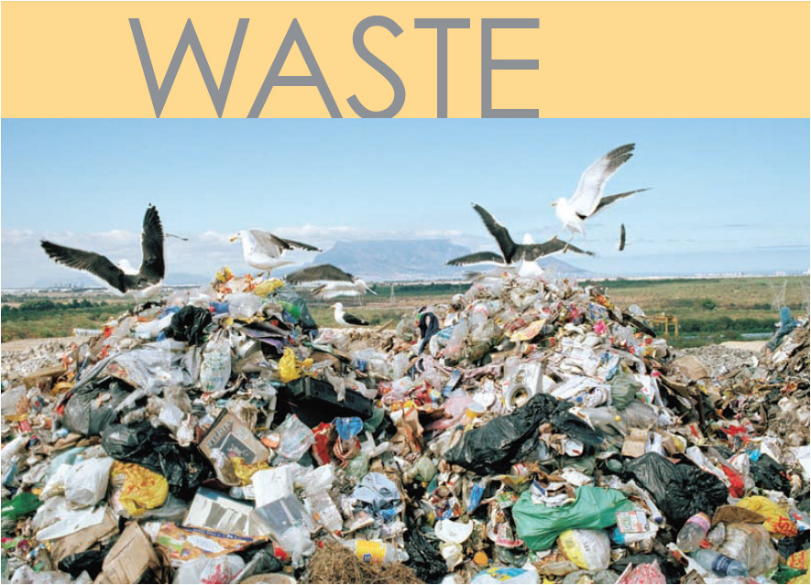

Slide 57
Solid-waste Disposal
Solid waste is any solid material that is of no use to humans and which needs to be disposed of in a safe and environmentally friendly way.

Slide 58
Solid-waste Disposal
Managing dumpsites for rehabilitation and prevention of soil and water pollution
The simplest and most cost effective way of disposing of solid waste is to bury it in landfill sites. A landfill site is a hole where solid waste is dumped and then covered by soil. However, this way of disposing of solid waste contributes to soil and groundwater pollution because rain seeps through the waste to produce a toxic substance called leachate. To prevent the toxic leachate from reaching the groundwater, a plastic liner is placed under the dumpsite area.
Rehabilitation of landfill sites occurs before it is closed down. This involves the covering of the old landfill site with clay soil, which is impermeable to water, and then it is covered with topsoil. Grass or other vegetation is then planted on the old landfill site. The growth of the plants stabilizes the area and the old landfill site may be used as a recreational area such as a park or a golf course.

Slide 59
Solid-waste Disposal
The need for recycling
Various methods may be used to manage solid waste, this includes the reduction of waste, re-using waste and recycling of waste.
Re-using waste products includes re-using plastic shopping bags, re-using glass and plastic containers – this helps to reduce the waste produced.
Recycling is a process whereby used materials/waste products are recycled to make new products, for example plastic, glass, tin and paper. The advantage of recycling is that it provides employment, reduces the use of raw materials and energy, and reduces air, ground and water pollution

Slide 60
Solid-waste Disposal
Using methane from dumpsites for domestic use: heating and lighting
Methane is a gas produced as a result of the decomposition of organic waste.
The methane gas can be used as a fuel.
Methane can be collected from landfill sites and used to generate electricity for domestic use – heat for cooking and electricity for lighting.

Slide 61
Solid-waste Disposal
Safe disposal of nuclear waste
South Africa also uses radioactive material such as uranium to power its nuclear power station at Koeberg in the Western Cape.
Unfortunately, a by-product of using uranium is nuclear waste that is still radioactive and therefore dangerous to living organisms.
The nuclear waste is stored in thick steel drums and buried in trenches at special protected sites.

