Slide 1
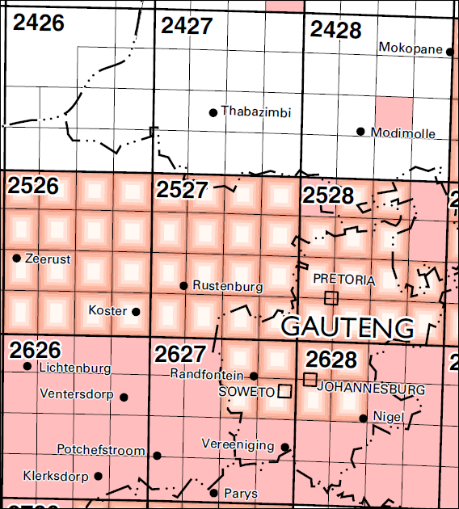
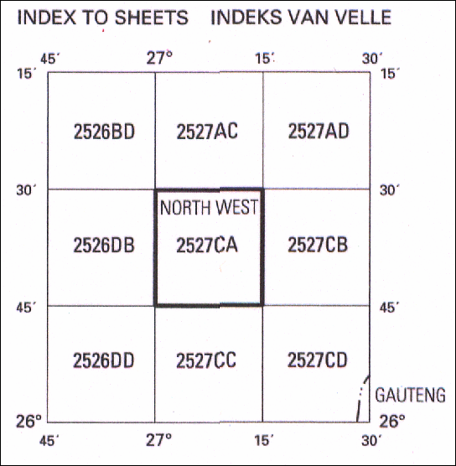
Rustenburg West - Map code
Notes:
Ask questions about the composition of mapcode, neighbouring maps and latitude and longitude

Slide 2
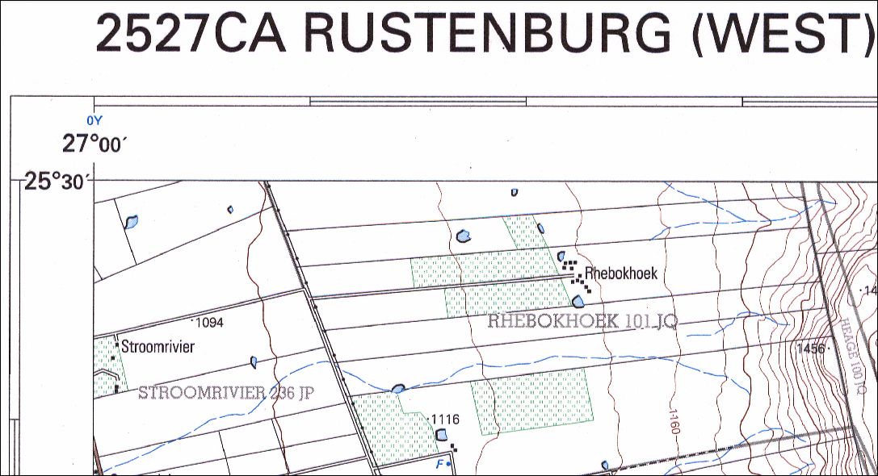
1. Grid reference link to map code 3. Find position – practice 2. Describe the change of slope from West to East
Notes:
Look at the map code and the top left hand side corner – see the latitude and longitude represented in the map code

Slide 3
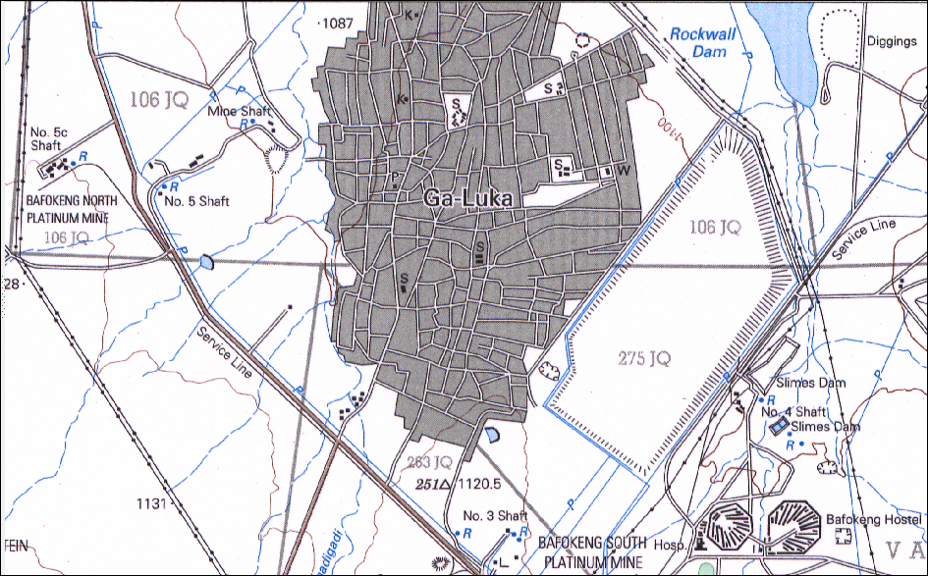
1. Identify the street pattern – advantages / disadvantages 2. Identify the main economic activity

Slide 4
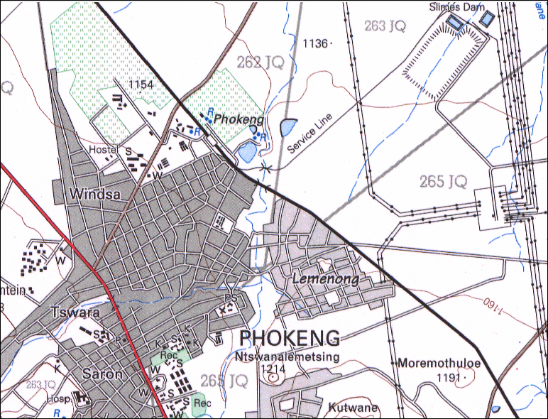
1. Street pattern - compare with previous 2. Power station – Function

Slide 5
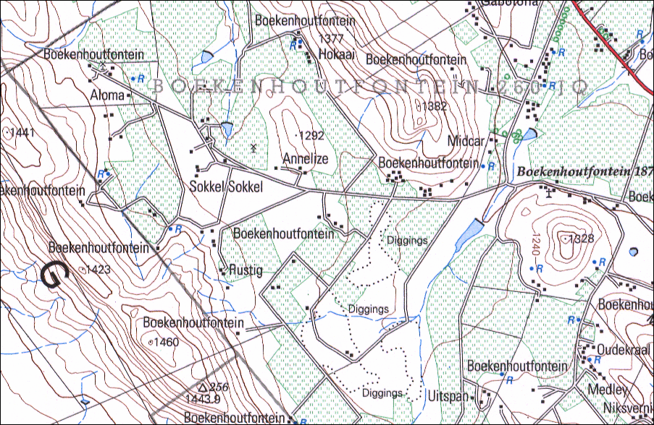
1. Identify landforms and direction of flow of river 2. Describe type of farming 3. Settlement pattern – advantages / disadvantages

Slide 6
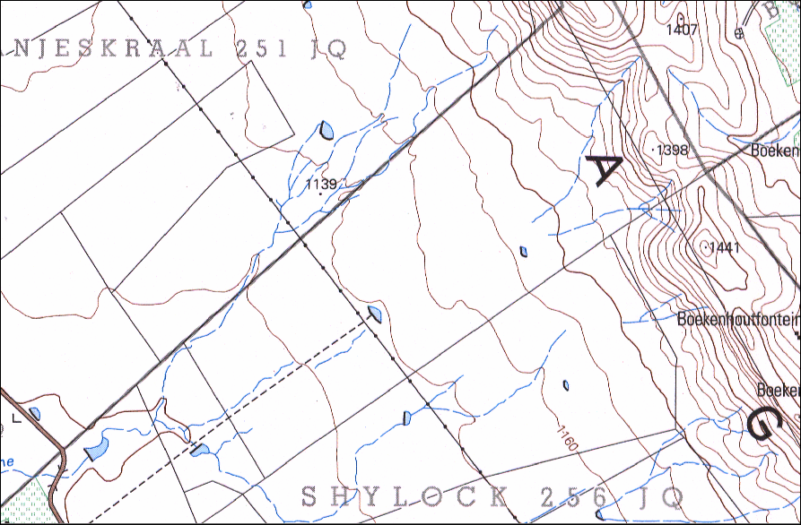
1. Drainage pattern 2. Slopes / landforms 3. Altitude 4. Types of rivers

Slide 7
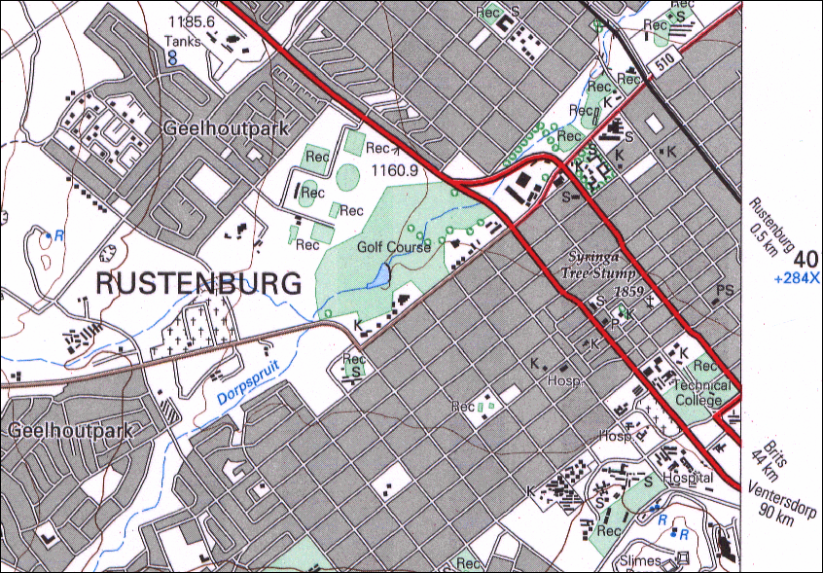
1. Street patterns 2. Land use zones 3. Reason for location 4. Neighbouring towns

Slide 8
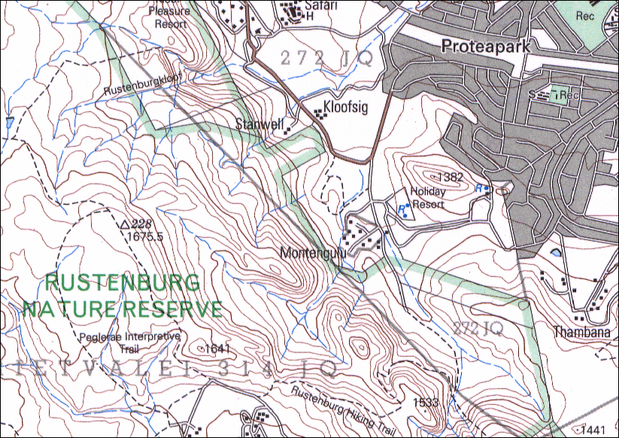
1. Street patterns 2. Land use zones 3. Reason for location 4. Recreational facilities

